Slide 1
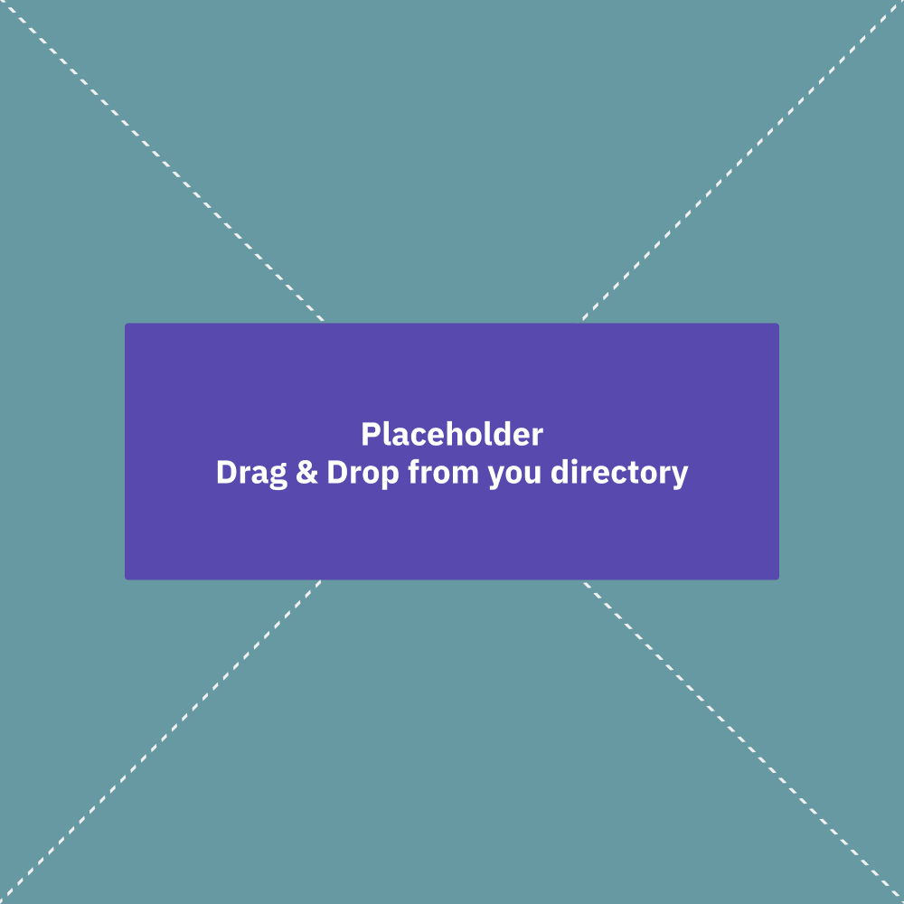



Personalization of Accessible Charts and Graphs
Marita Vindedal
Ted Gies
Frank Elavsky
Øystein Moseng
Customized icon/illustration
or, an image of Chart / Photo
CSUN 2025
12 March 2025 2:20 PT
Grand GH

Slide 2
Outline
(2 min) Everyone: Intro of us, brief
(2 min) Ted: How collab started - impact of vendor collaboration
(1 min) Øystein: Briefly on Frank collab - impact of research collaboration
(2 min) Ted: Why data access matters. COVID data example? Whitepapers?
(2 min) Ted: Presentation framing - which part of dataviz a11y are we talking about.
(10 min) Frank: Why personalization, what’s the problem?
What’s more accessible to me could make it worse for you
Great power comes great responsibility - start with something accessible, otherwise it’s just a burden
Personalization is a common solution for accessibility elsewhere (OS, video games, …). Believed in by researchers as a valid road ahead.
Data collection from users, auto-personalization
Highcharts does a bit of personalization already - OS settings. Not enough - we think we can do more.
(2 min) Ted: Usability testing framework - how do we test? What are we looking for in the solution?
(5 min) Frank: Prestudy highlights - what do people want to customize?
Approach
Findings
(7 min) Marita: Integration study - how do we make this available to Highcharts users
Approach - picked most obvious settings, iterated on wording & more
Findings
(1 min) Øystein: Next steps

Slide 3
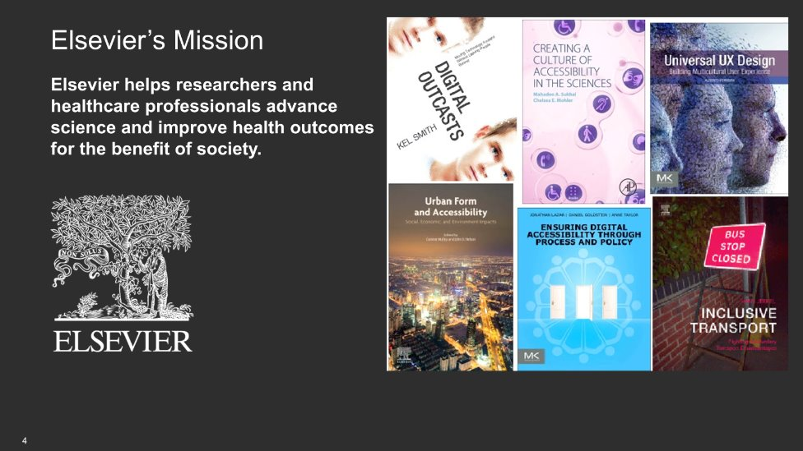

Slide 4
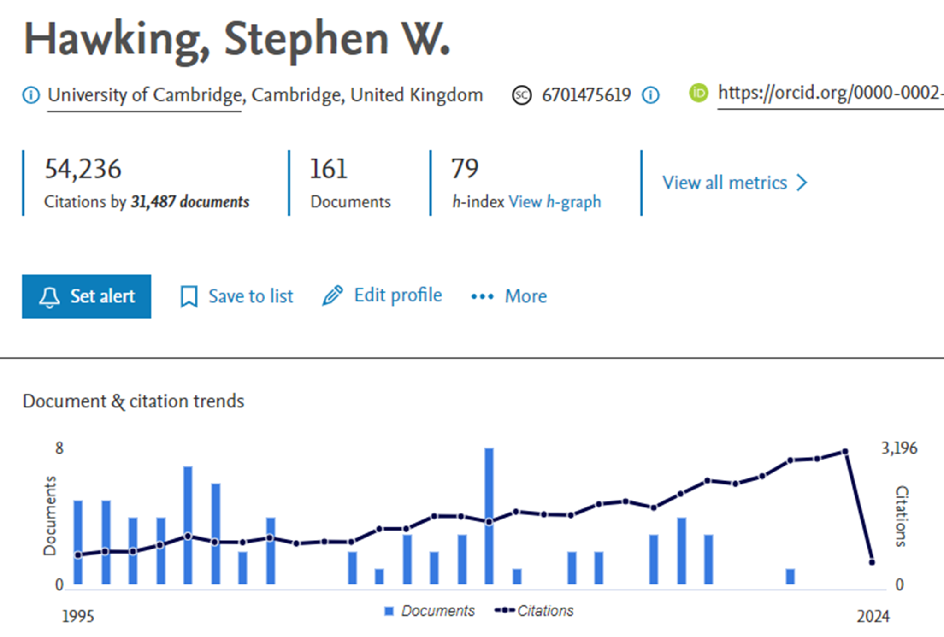
Elsevier Relies on Highcharts to Depict Researcher Performance

Slide 5
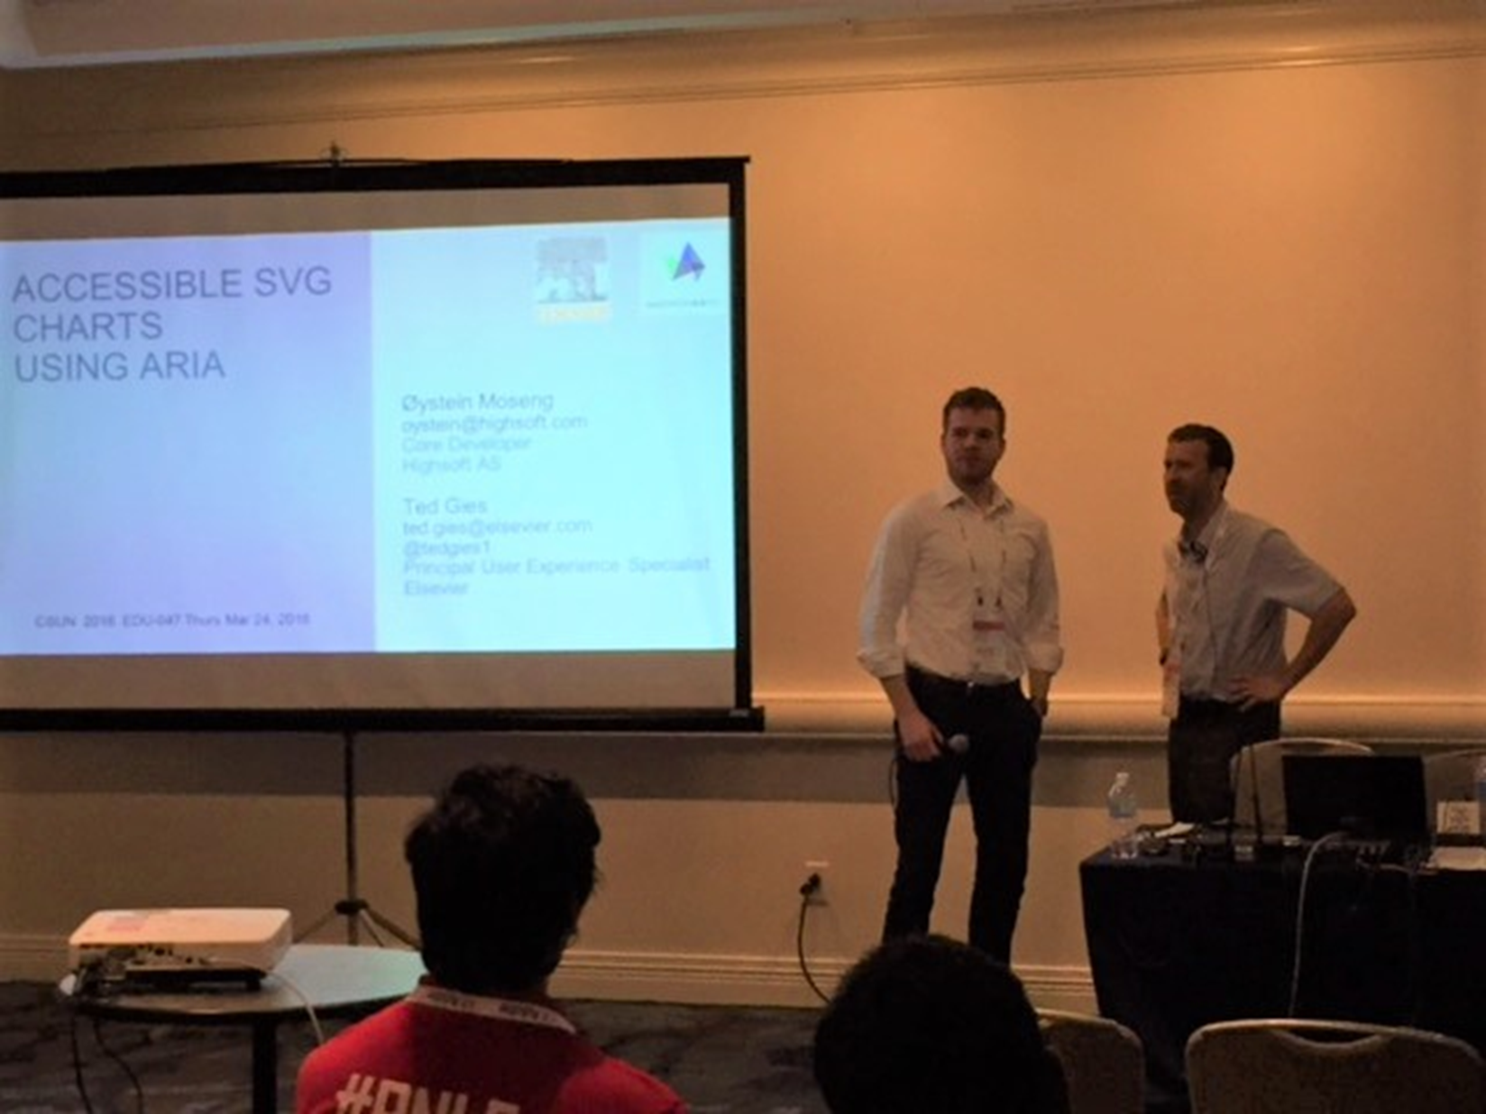
Elsevier + Highcharts (Collaborating Since 2015!)
“Hi Øystein, we are currently using Highcharts as our data visualization engine for our Scopus product. Would you like to work on making the functionality work better for accessibility (like keyboard users?)”

Slide 6
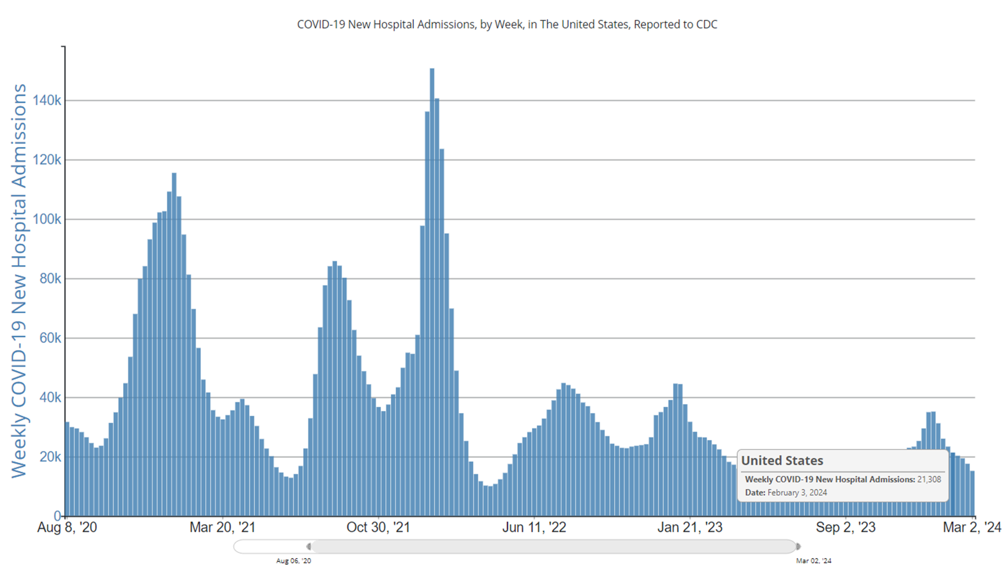
Science and Health Depicts Serious Data in Charts and Graphs Bar Chart Depicting Weekly COVID-19 Cases Aug 2020 through Mar 2024

Slide 7
“There are probably ways to look for the trend, but I never look because I expect it to be inaccessible.”
Stanford COVID-19 2021 Viz study (A. Siu, et al) – Feedback from Person who is Visually impaired
Notes:
So graphs are largely inaccessible, but what about the trends, are they accessible?
Here’s a representative quote from Stanford paper about the low expectations around spotting trends like spikes in COVID cases and hotspots in geo maps.
“there are probably ways to look for the trend but I never look because I expect it to be inaccessible” (P8).
COVID-19 Highlights the Issues Facing Blind and Visually Impaired People in Accessing Data on the Web (Stanford HCI Group, 2021)

Slide 8
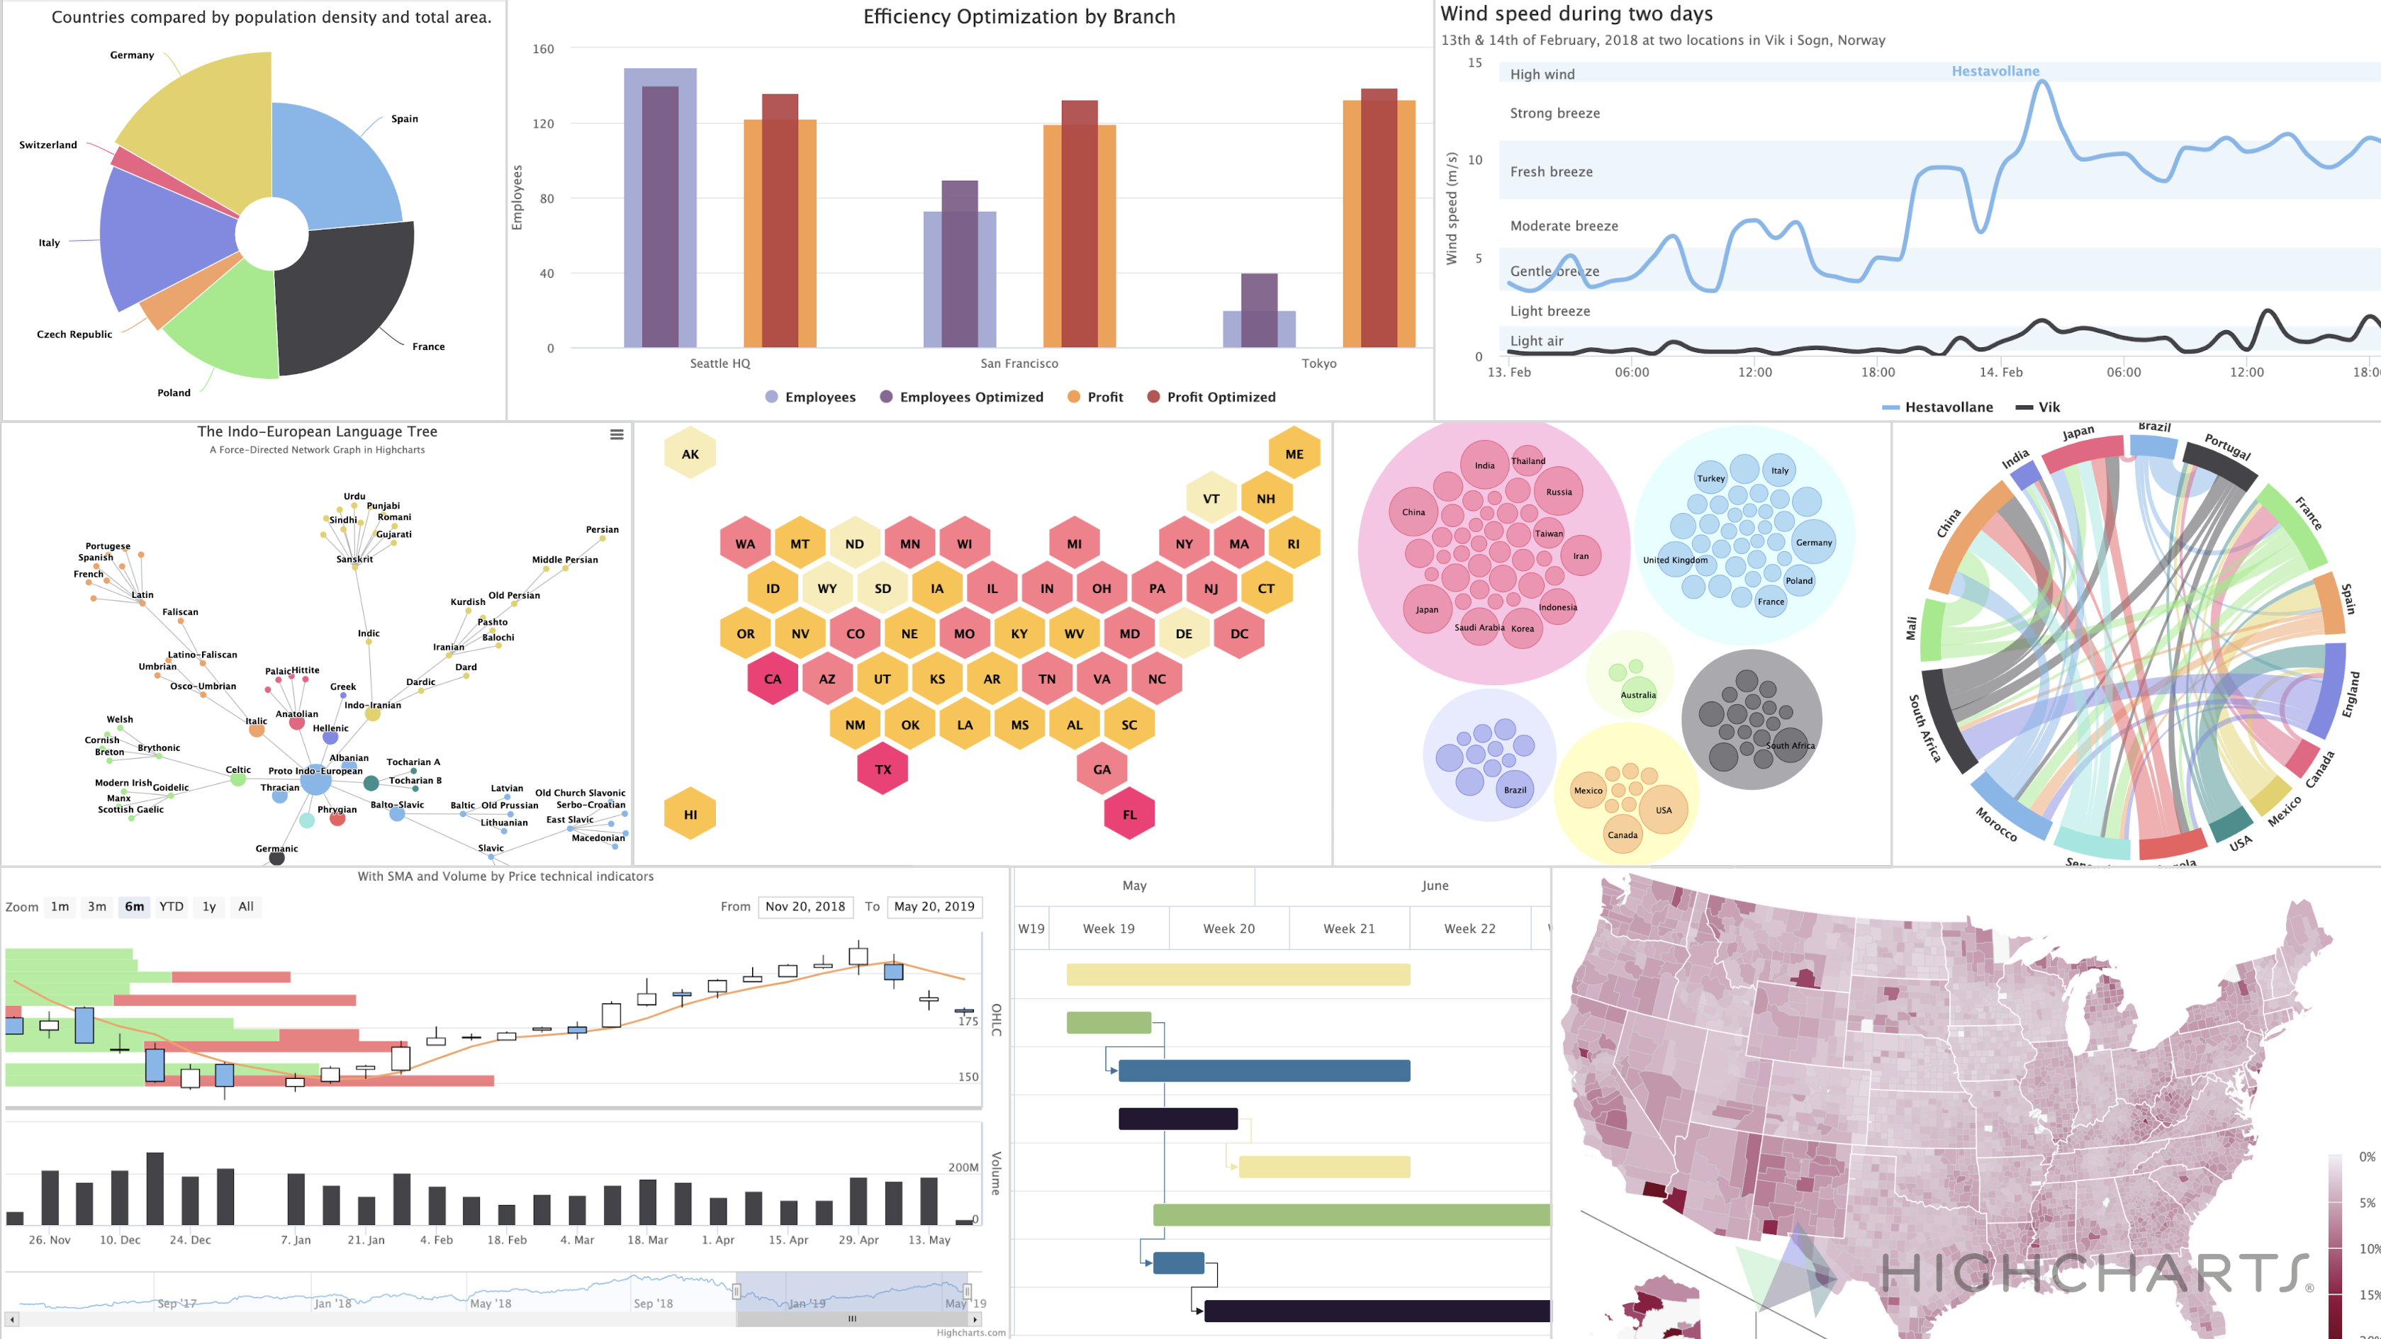

Slide 9
Our Current Research Focus in Accessible Data Vis
Next Talk: Interactive Charts for Everyone Thursday 9:20 AM Grand CD
Provide Non-visual Access
Data Points
Data Structure
Screen Reader Compatibility
Trends
Tactile
Auditory
Flexibility/Freedom of Exploration
Keyboard Quick Keys
Application Role
Table Vs. Marked Up SVG
Intuitive Orientation Cues
Reduce Information Overload
Verbosity
Large Datasets
Sparklines
Curve Smoothing
AI Summaries
Increase Interactivity and Engagement
Provide multi-sensory experience of data
Efficient Keyboard Model
Ability to discover trends
Device independent interatction
Increase User Efficiency
Flexible ways to find data
Improve orientation
Improve Usability overall
Simple KB commands

Slide 10
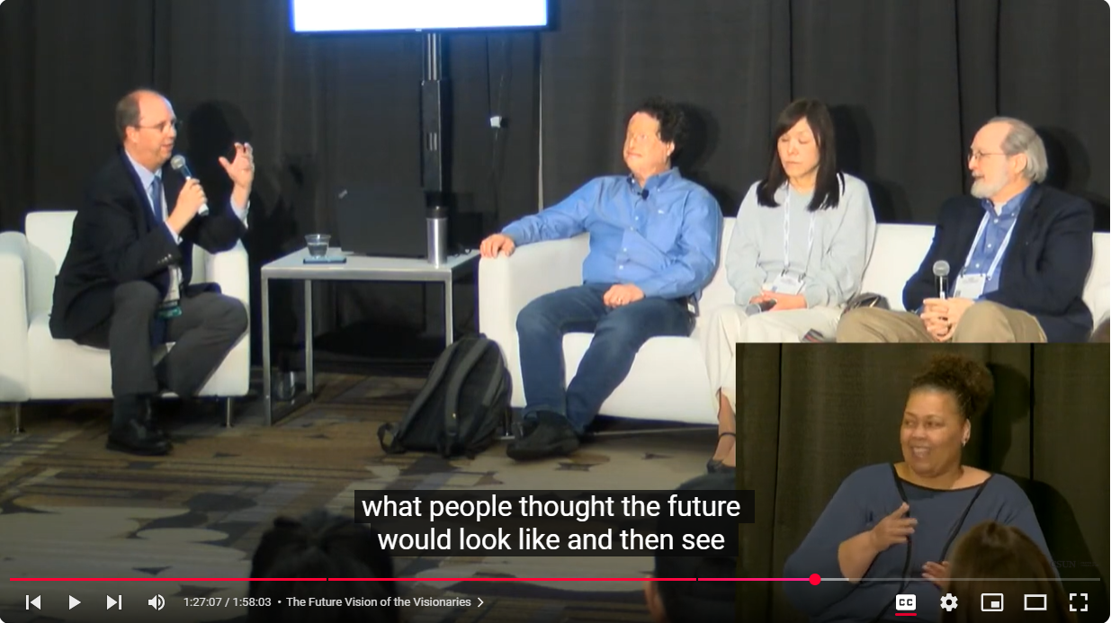
Personalization – The Future of Accessible User Interfaces?
The Future of the Visionaries (CSUN 2023) The interface adapts to us rather than Assistive Technology or User Having to Adapt to the interface.
Panelists
Mike Paciello
Dr. Josh Miele
Dr. Gregg Vanderheiden
Dr. Chieko Asakawa

Slide 11
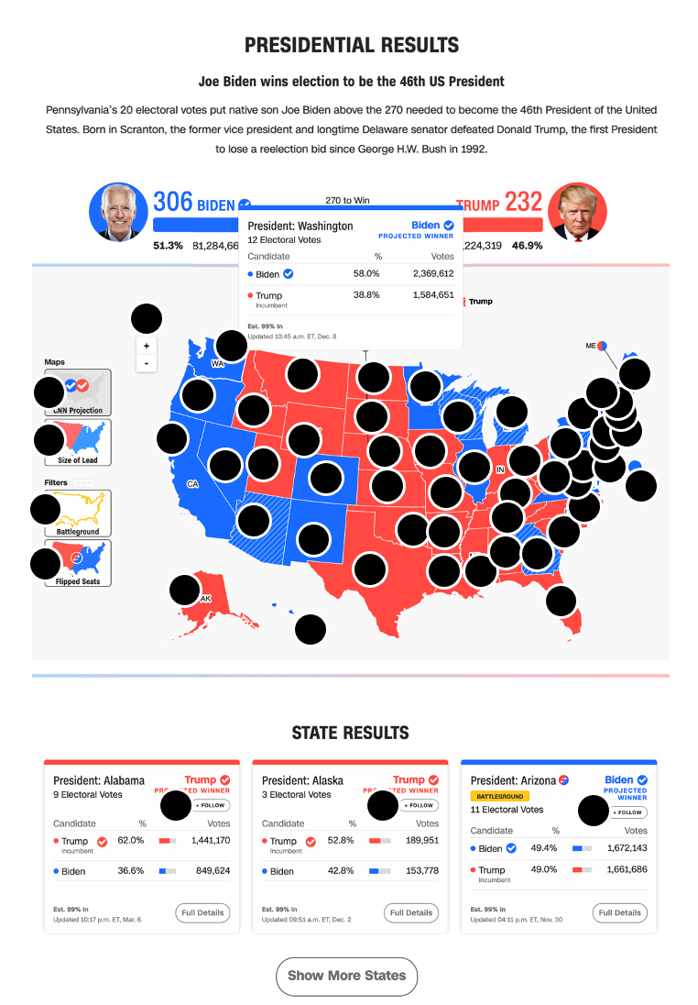
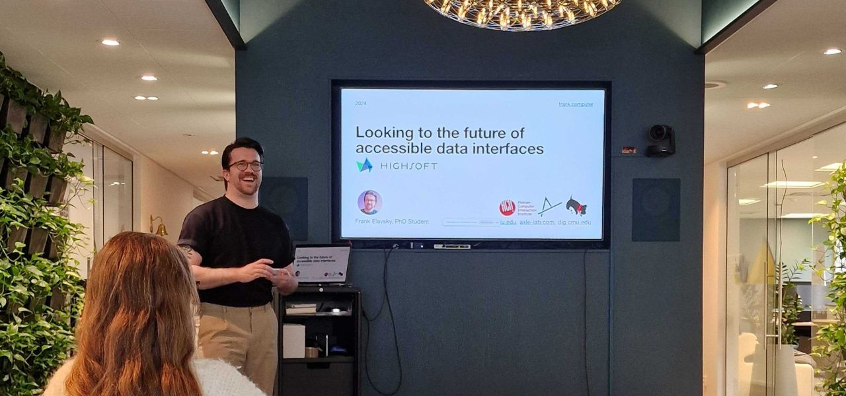
Teaching accessibility and visualization
Notes:
Hci researcher, teach, chartability, but I get q/a - common problem arises

Slide 12
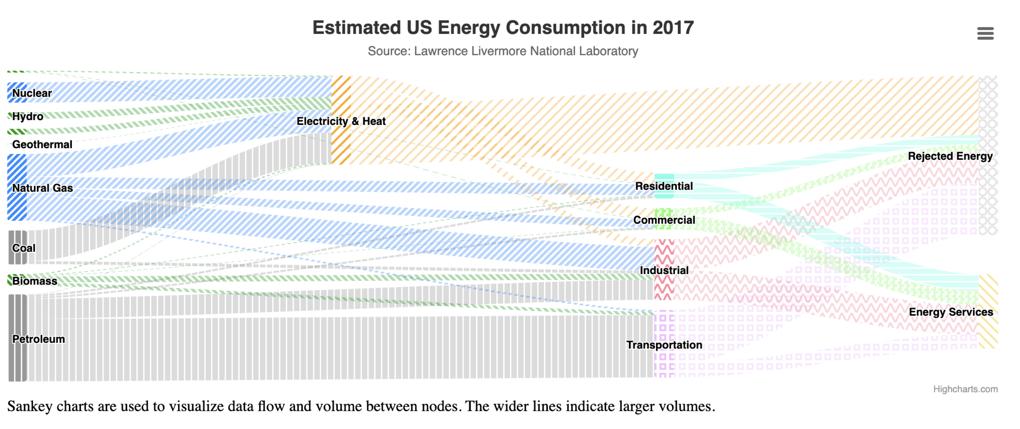
What about this visualization might be a barrier?
Notes:
Let's say someone builds a pretty darn accessible chart – like this one shown here. Shown here is a sankey diagram. This chart visualizes flows and the flows look like pipes, or noodles, of different thicknesses. Noodles in the sankey that are thick like lasangna noodles have big numbers and the thin ones, like angel hair pasta, have small values. According to standard testing, this is really accessible.

Slide 13
What about this visualization might be a barrier?
Font size too small

Slide 14
What about this visualization might be a barrier?
Font size too small
Black text on light background is hard

Slide 15
What about this visualization might be a barrier?
Font size too small
Black text on light background is hard
Textures + colors are overwhelming

Slide 16
What about this visualization might be a barrier?
Font size too small
Black text on light background is hard
Textures + colors are overwhelming
Explanation doesn't have a summary, it isn't enough

Slide 17
Can we fix this?

Slide 18
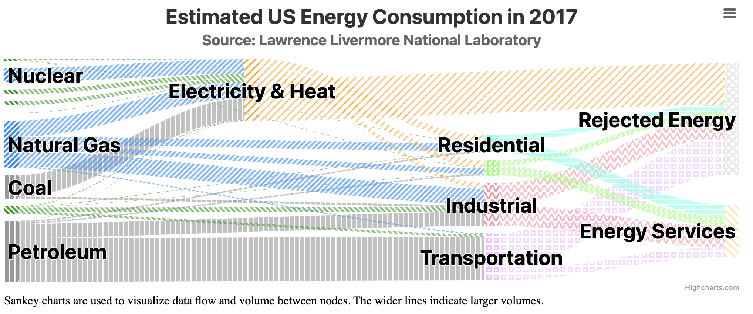
Maybe we can bump up the text size

Slide 19
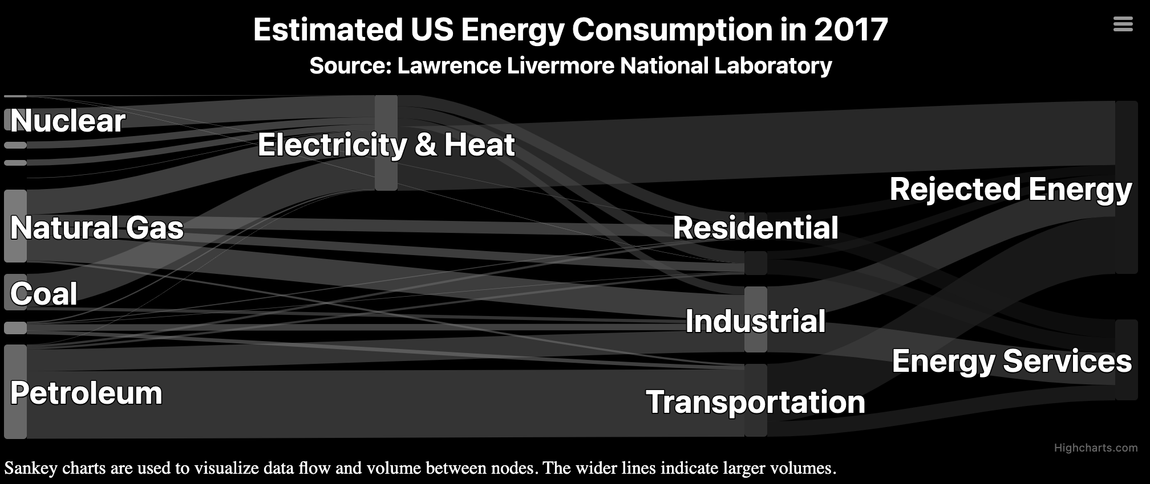
We can reduce visual complexity too

Slide 20
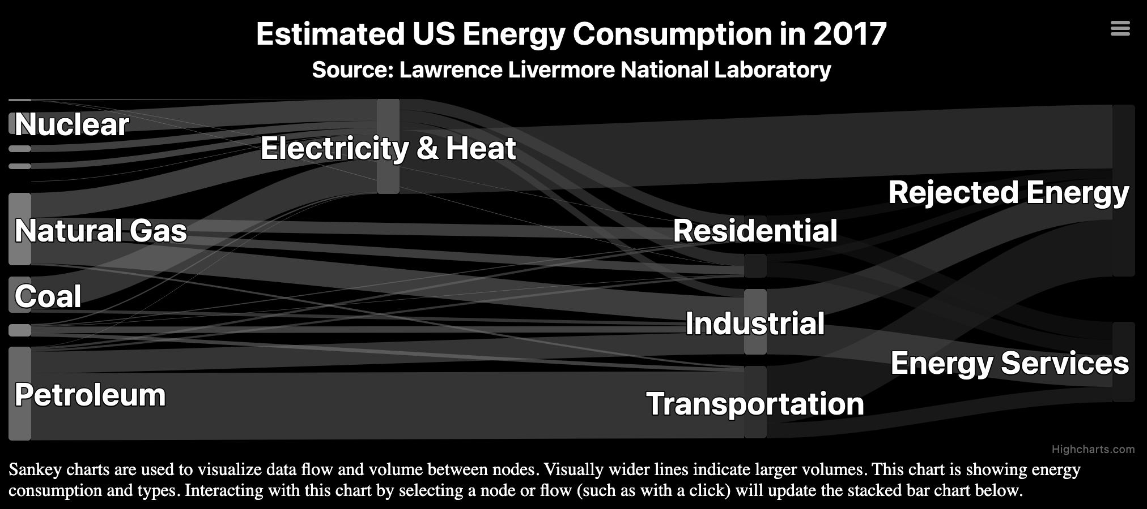
We can add a more descriptive explanation

Slide 21
Is this the perfect, most accessible design?

Slide 22
Bad news...

Slide 23
Bad news...
This design has accessibility issues too

Slide 24
There is no such thing as a single, perfect visualization

Slide 25
One design cannot fit all

Slide 26

Why should our chart designs be one-size-fits-all?

Slide 27
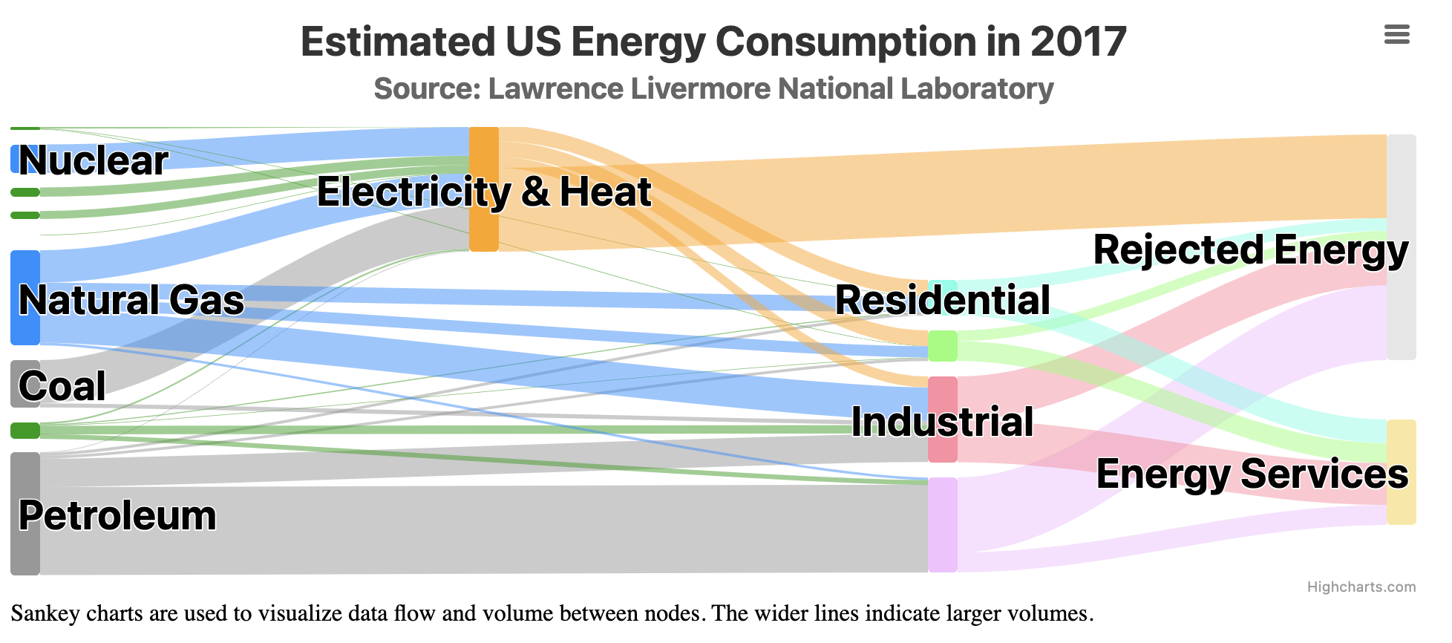
Good design enables personalization

Slide 28
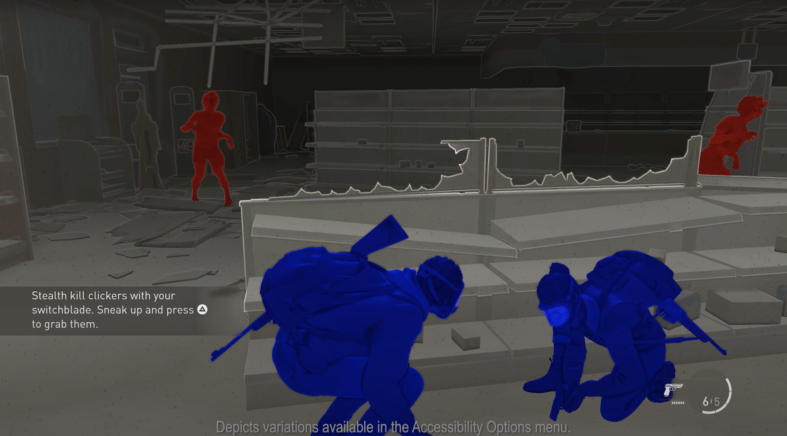
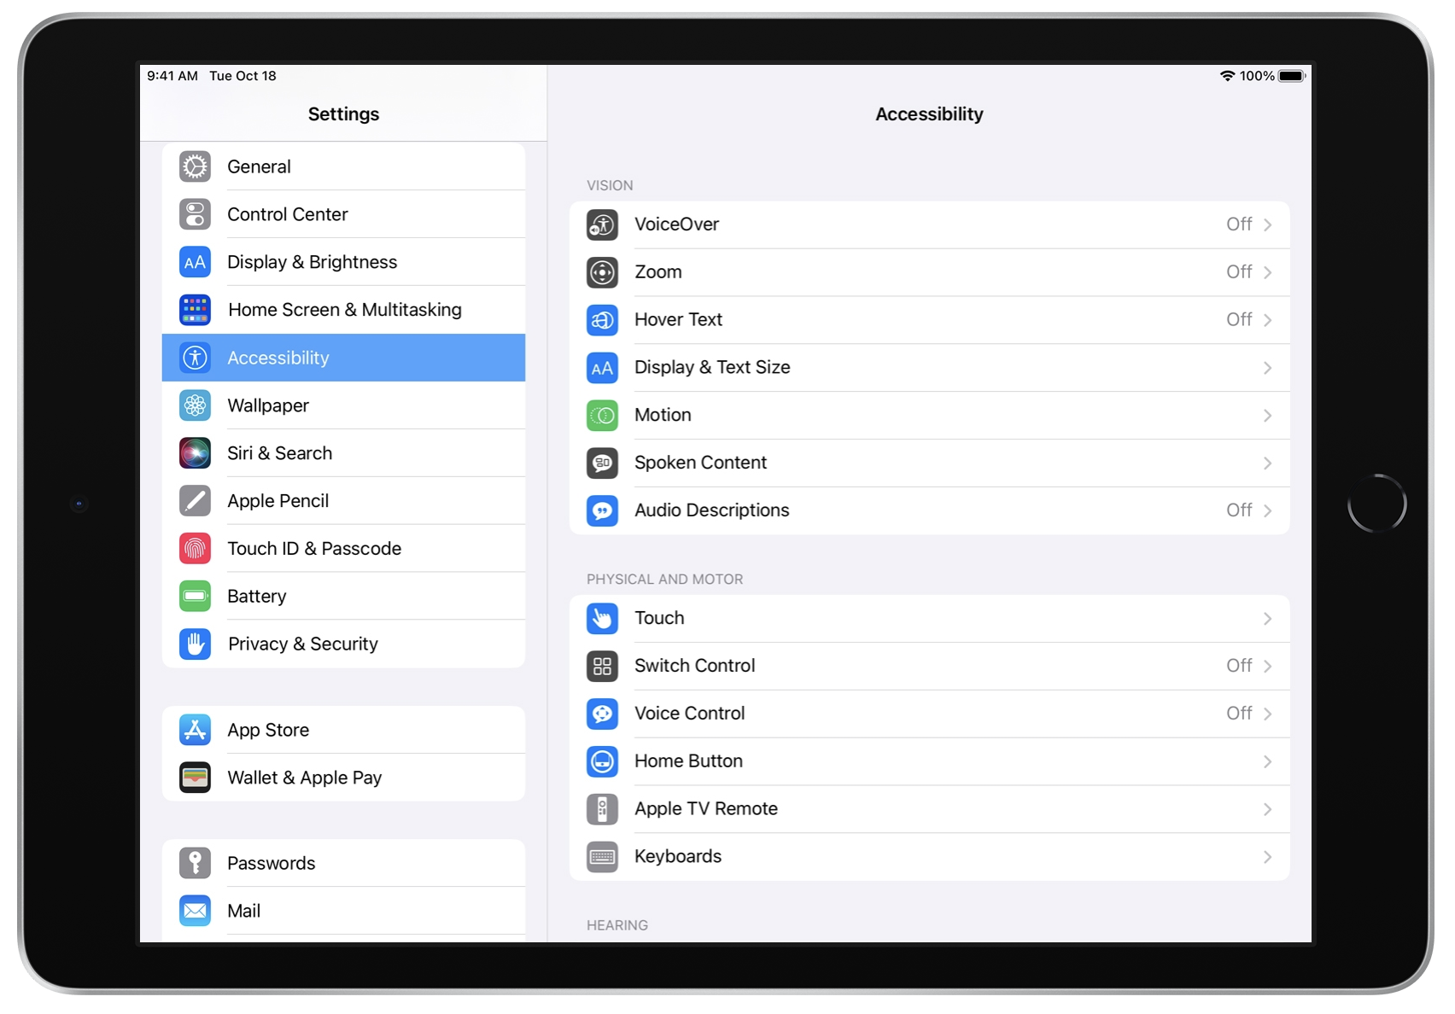
We have been enabling personalization for years
Video games
Devices and operating systems
The Last of Us 2 has more than 60 settings
"Make it yours" is the motto for Apple's accessibility personalization

Slide 29
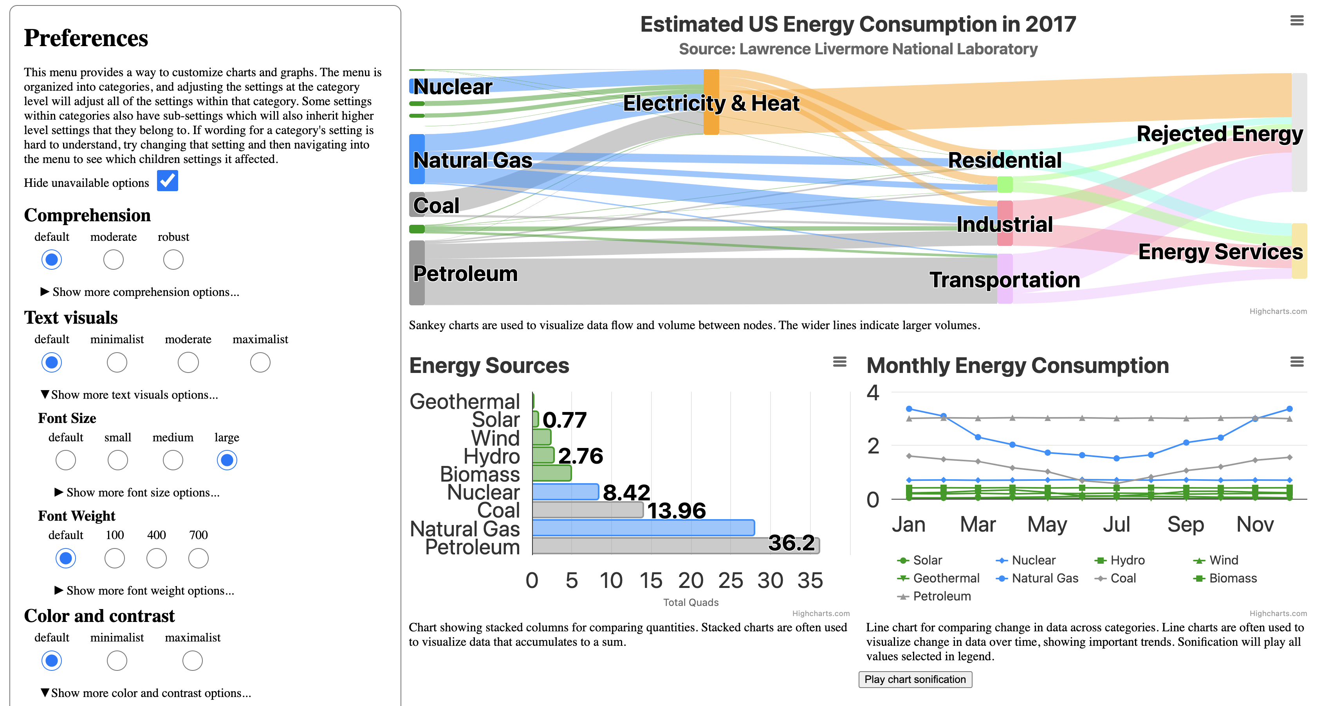
We built a preferences menu!

Slide 30
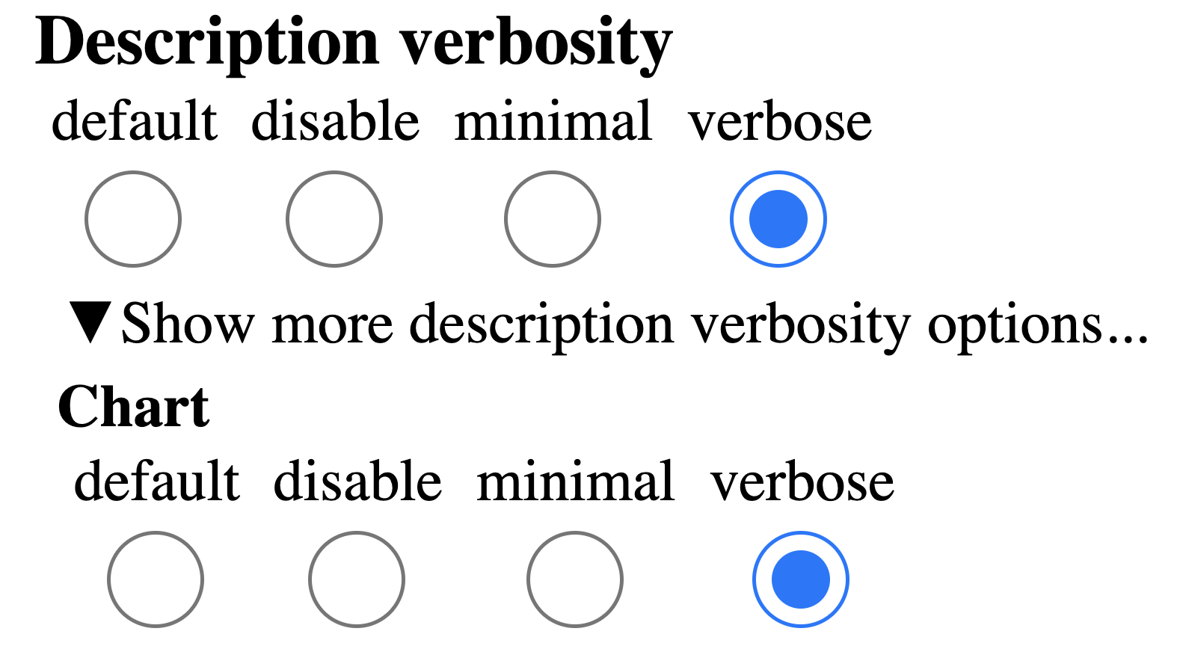
We took a pass at customization options: 195 categories and 774 choices

Slide 31
We took a pass at customization options: 195 categories and 774 choices

Slide 32
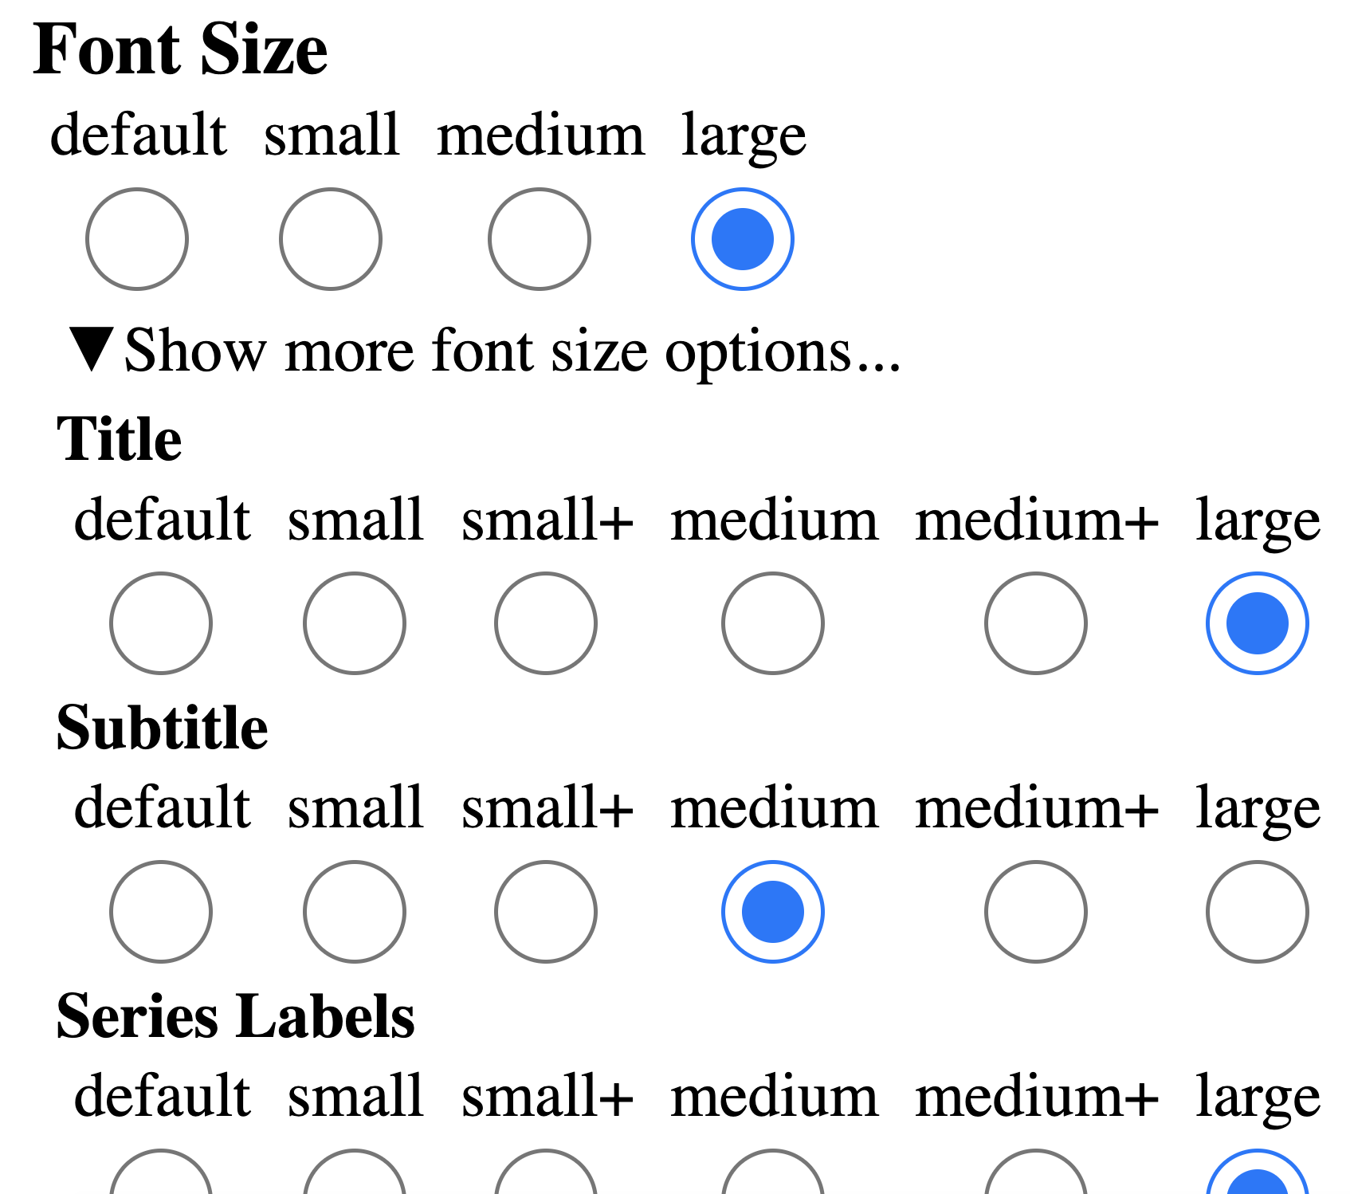
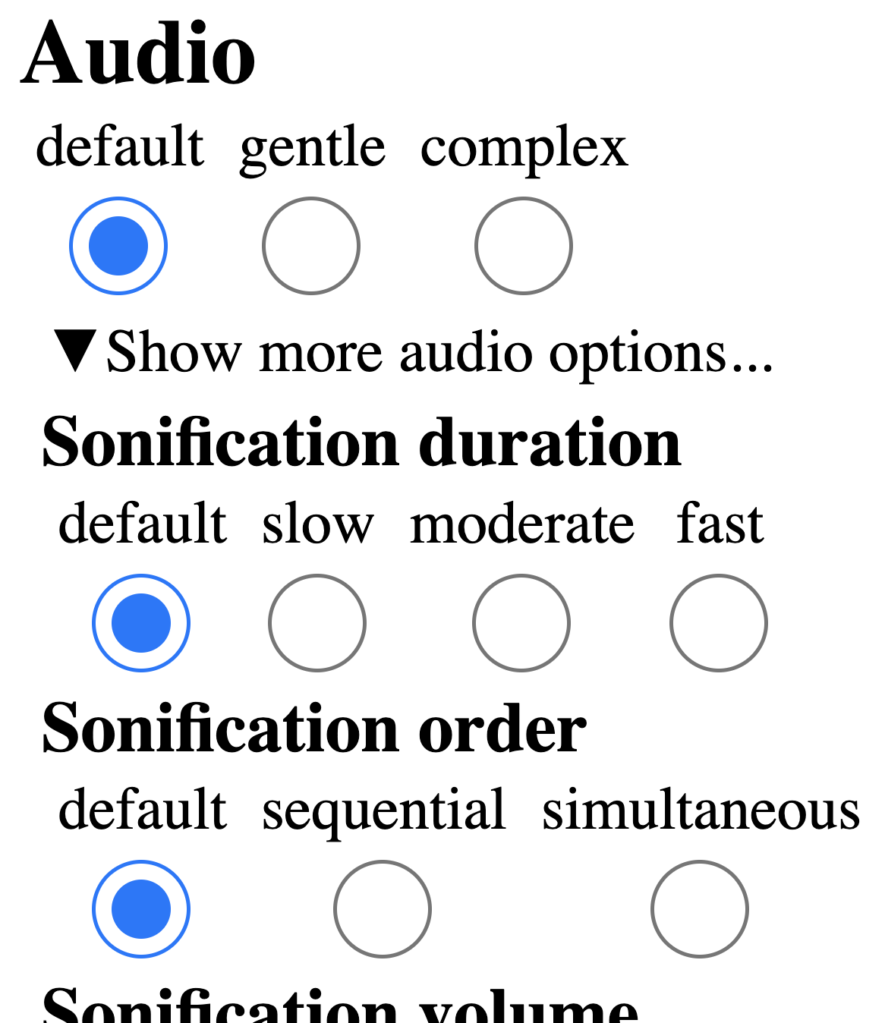
We took a pass at customization options: 195 categories and 774 choices

Slide 33
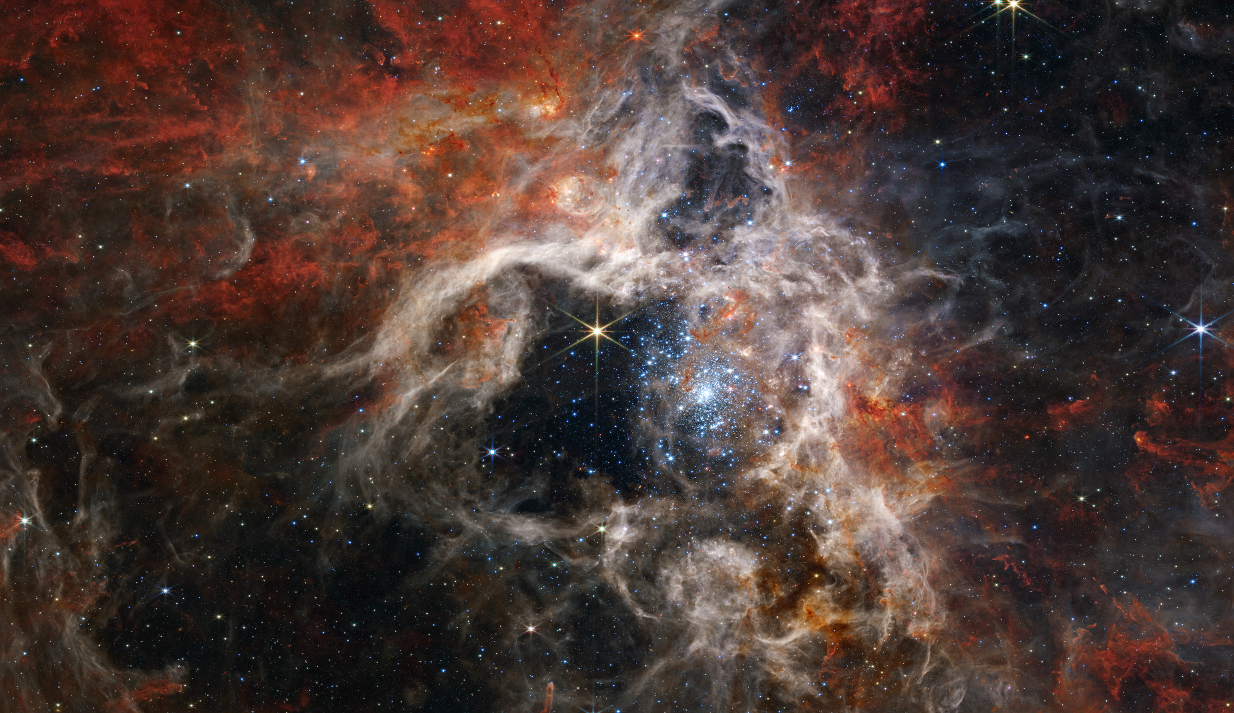
There are far more unique ways to personalize one visualization than there are atoms in our universe
(1.0e80 vs 6.83e114)
Image credit: NASA

Slide 34




We don't want users to build their own access from scratch!

Slide 35

Don't give users garbage and expect them to clean it up

Slide 36
"Users: Fix our garbage" (modern overlay strategies)

Slide 37
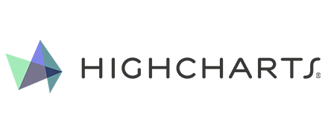



Collaborating with the best: Fundamental + Product research

Slide 38
Why did we choose a "Preferences" menu?

Slide 39
Why did we choose a "Preferences" menu?
Familiar design (easier to test our questions)
"Accessibility settings" (has worse adoption/use)
Inspectable (state & available interactions are perceivable)
Foundational prototype (leads to future UX ideas)

Slide 40

Why did we choose a "Preferences" menu?
Familiar design (easier to test our questions)
"Accessibility settings" (has worse adoption/use)
Inspectable (state & available interactions are perceivable)
Foundational prototype (leads to future UX ideas)
Auto-adapting, smart systems need goals

Slide 41
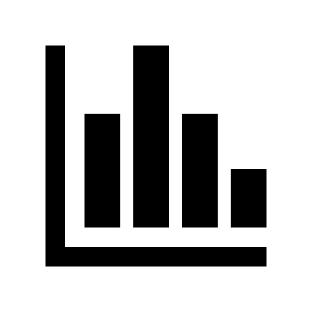

Why did we choose a "Preferences" menu?
Familiar design (easier to test our questions)
"Accessibility settings" (has worse adoption/use)
Inspectable (state & available interactions are perceivable)
Foundational prototype (leads to future UX ideas)
Auto-adapting, smart systems need goals
Direct-manipulation interfaces need to store system state

Slide 42

Why did we choose a "Preferences" menu?
Familiar design (easier to test our questions)
"Accessibility settings" (has worse adoption/use)
Inspectable (state & available interactions are perceivable)
Foundational prototype (leads to future UX ideas)
Auto-adapting, smart systems need goals
Direct-manipulation interfaces need to store system state
Chat and voice-based interaction needs target language

Slide 43
What do people with disabilities want to personalize in their charts?

Slide 44
We gave 9 BLV users and 4 developers some levers to pull

Slide 45
(What is accessible for one...)
“If anything has dark mode? That’s great. I wish everything used dark mode.”
Participant #4

Slide 46
(...might be a barrier for another.)
“Oh, I can’t use dark mode at all. I hate when websites have [dark mode] because it can be virtually impossible to use.”
Participant #7

Slide 47

Fundamental research: Guiding principles
Malleable interfaces need guardrails
It is possible to design harmful visualizations, so system designers should anticipate ways to help users personalize safely.

Slide 48

Fundamental research: Guiding principles
Malleable interfaces need guardrails
It is possible to design harmful visualizations, so system designers should anticipate ways to help users personalize safely.
Our ethical responsibility: Accessible defaults first
Some users won't want to personalize or manipulate interfaces at all, so they will still rely on smart, effective defaults.

Slide 49

Fundamental research: Guiding principles
Malleable interfaces need guardrails
It is possible to design harmful visualizations, so system designers should anticipate ways to help users personalize safely.
Our ethical responsibility: Accessible defaults first
Some users won't want to personalize or manipulate interfaces at all, so they will still rely on smart, effective defaults.
Persistence, profiles, and "effort-to-usage" ratio
Everything about malleable interfaces should save users time and energy. Let them save, reuse, and share their personalization.

Slide 50
Persistence matters:
“What if I come back to this? Will I lose this? Do I need to do it again?”
Participant #6

Slide 51
Profiles enable sharing:
“I customize my tech a lot... But most people [don't]. So I love when I can share [my customizations] with others.”
Participant #3

Slide 52
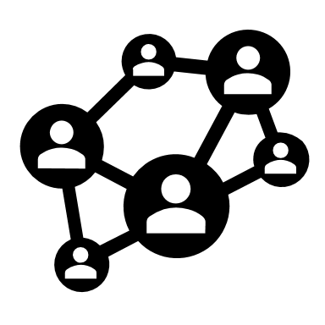
Fundamental research: Guiding principles
Malleable interfaces need guardrails
It is possible to design harmful visualizations, so system designers should anticipate ways to help users personalize safely.
Our ethical responsibility: Accessible defaults first
Some users won't want to personalize or manipulate interfaces at all, so they will still rely on smart, effective defaults.
Persistence, profiles, and "effort-to-usage" ratio
Everything about malleable interfaces should save users time and energy. Let them save, reuse, and share their personalization.
Interoperability: everyone's job
One visualization library isn't enough: the way users personalize a chart in one place should carry over to other platforms and tools.

Slide 53
Prototyping and user testing in Highcharts
Notes:
Frank told you about step 1
Introducing second phase
Integration study on how to make this available to Highcharts users

Slide 54
How to make this available to Highcharts users
Placement of button
Creating proof of concept
Iterative design approach
User testing
Notes:
Placement of button in the chart
Cog wheel
We put the preferences button upper right corner of a chart.
Creating a proof of concept
We took a handful of options to start with, based on Frank’s pre-study.
Iterative design approach
Test, refine and integrate functionality as we go.
First version of proof of concept for user testing is not the same as the last one
User testing
live user testing with user testers from BIT.
ask questions, look at shared screen and shared audio
get real time feedback on how users interact with our proof of concept.

Slide 55
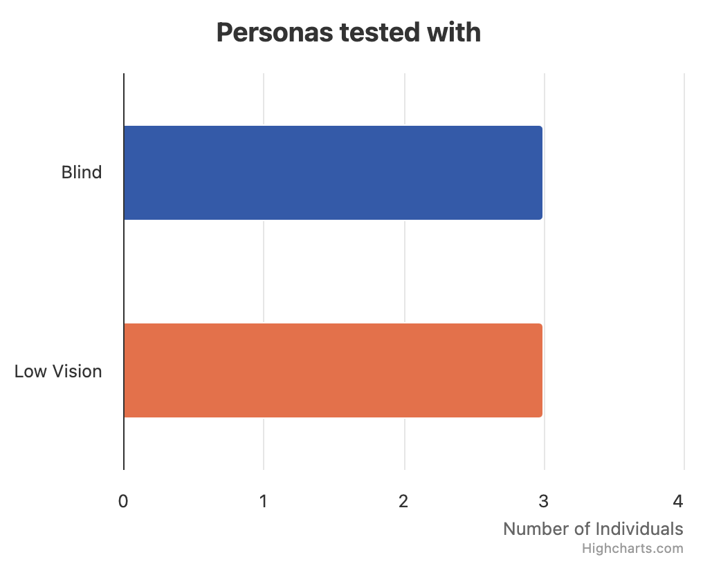
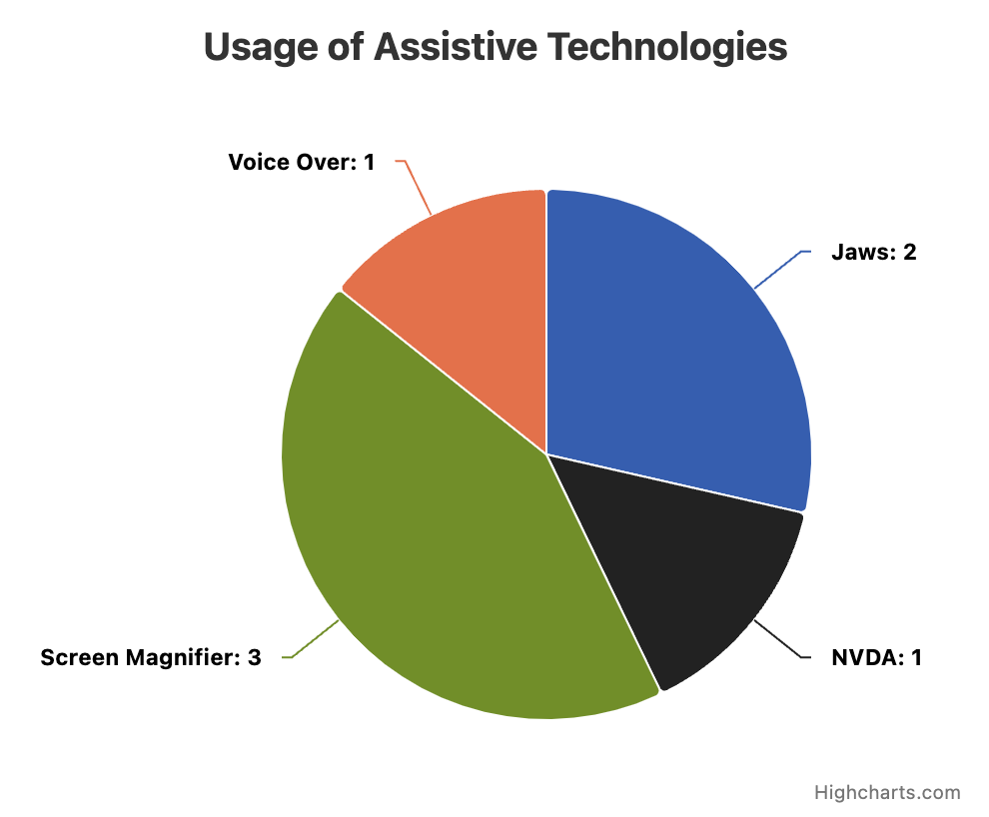
User tester demographics
Notes:
As you can see on the bar chart
3 blind
3 low vision
As you can see on the pie chart of which assistive technology used
1 VoiceOver
2 Jaws
1 NVDA
3 screen magnifier

Slide 56
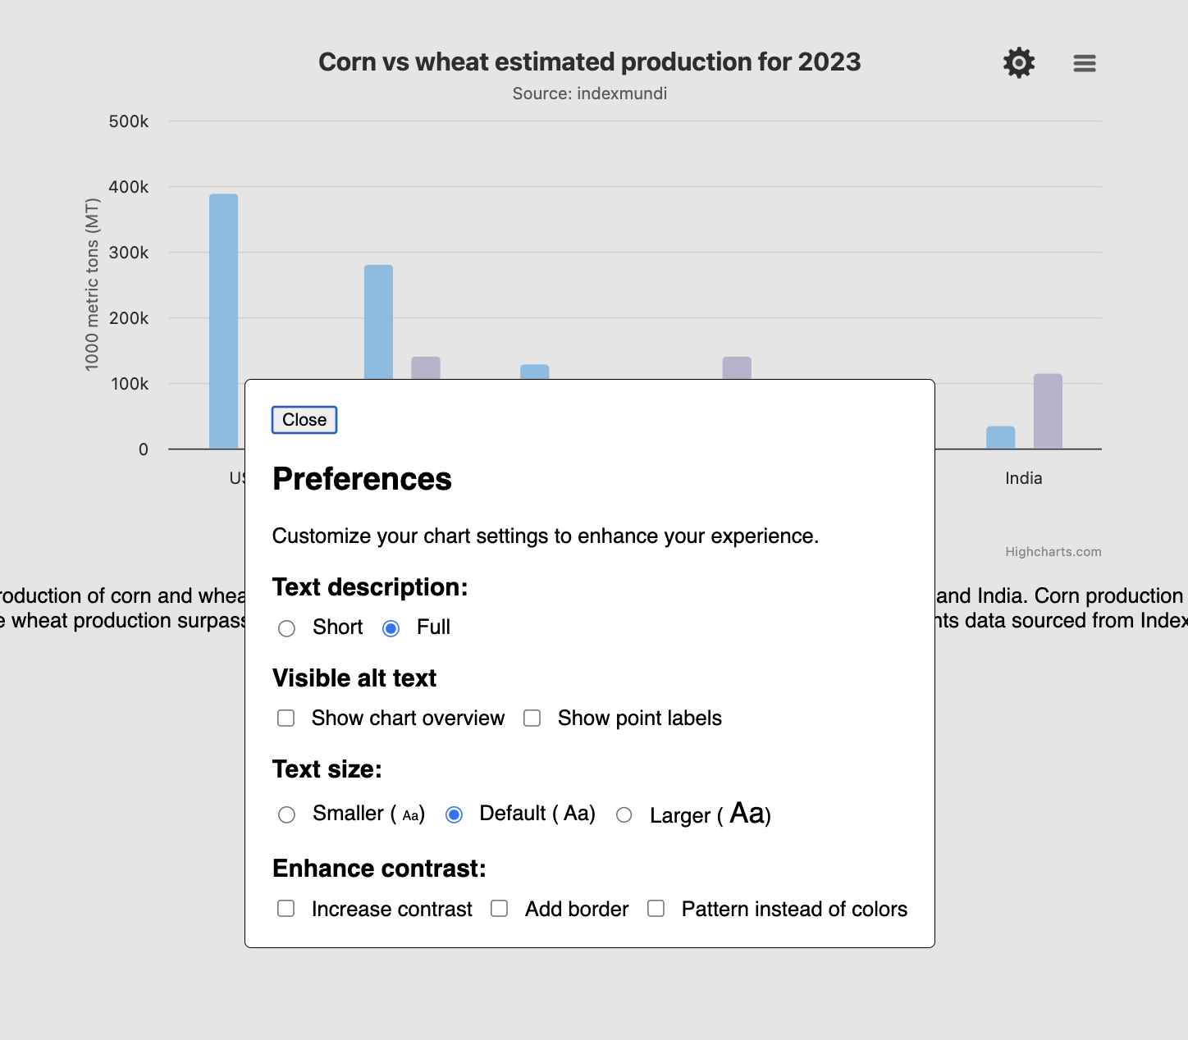
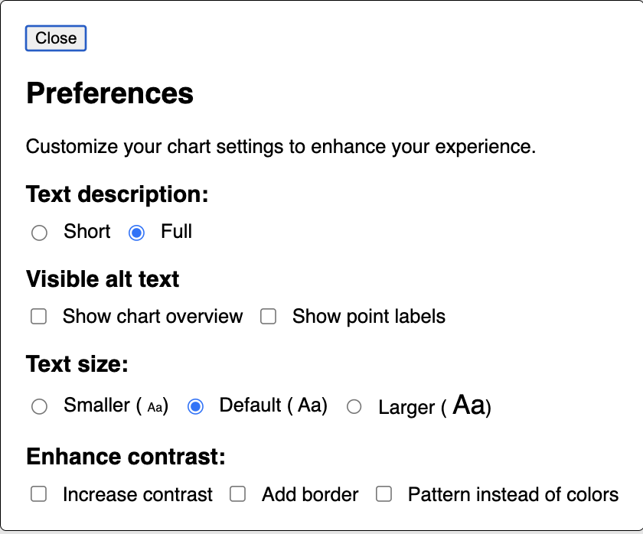
Initial prototype in Highcharts
Notes:
So I’m now showing an image of how the initial prototype looked like with the 4 settings
Short dialog with 4 settings
Text description short/full
Visible alt text
Text size
Enhance contrast
Low contrast on the bars --> Hint to click on the menu for low vision users
Preferences twice --> Hint to click on the menu for screen reader users
Free exploration without context

Slide 57
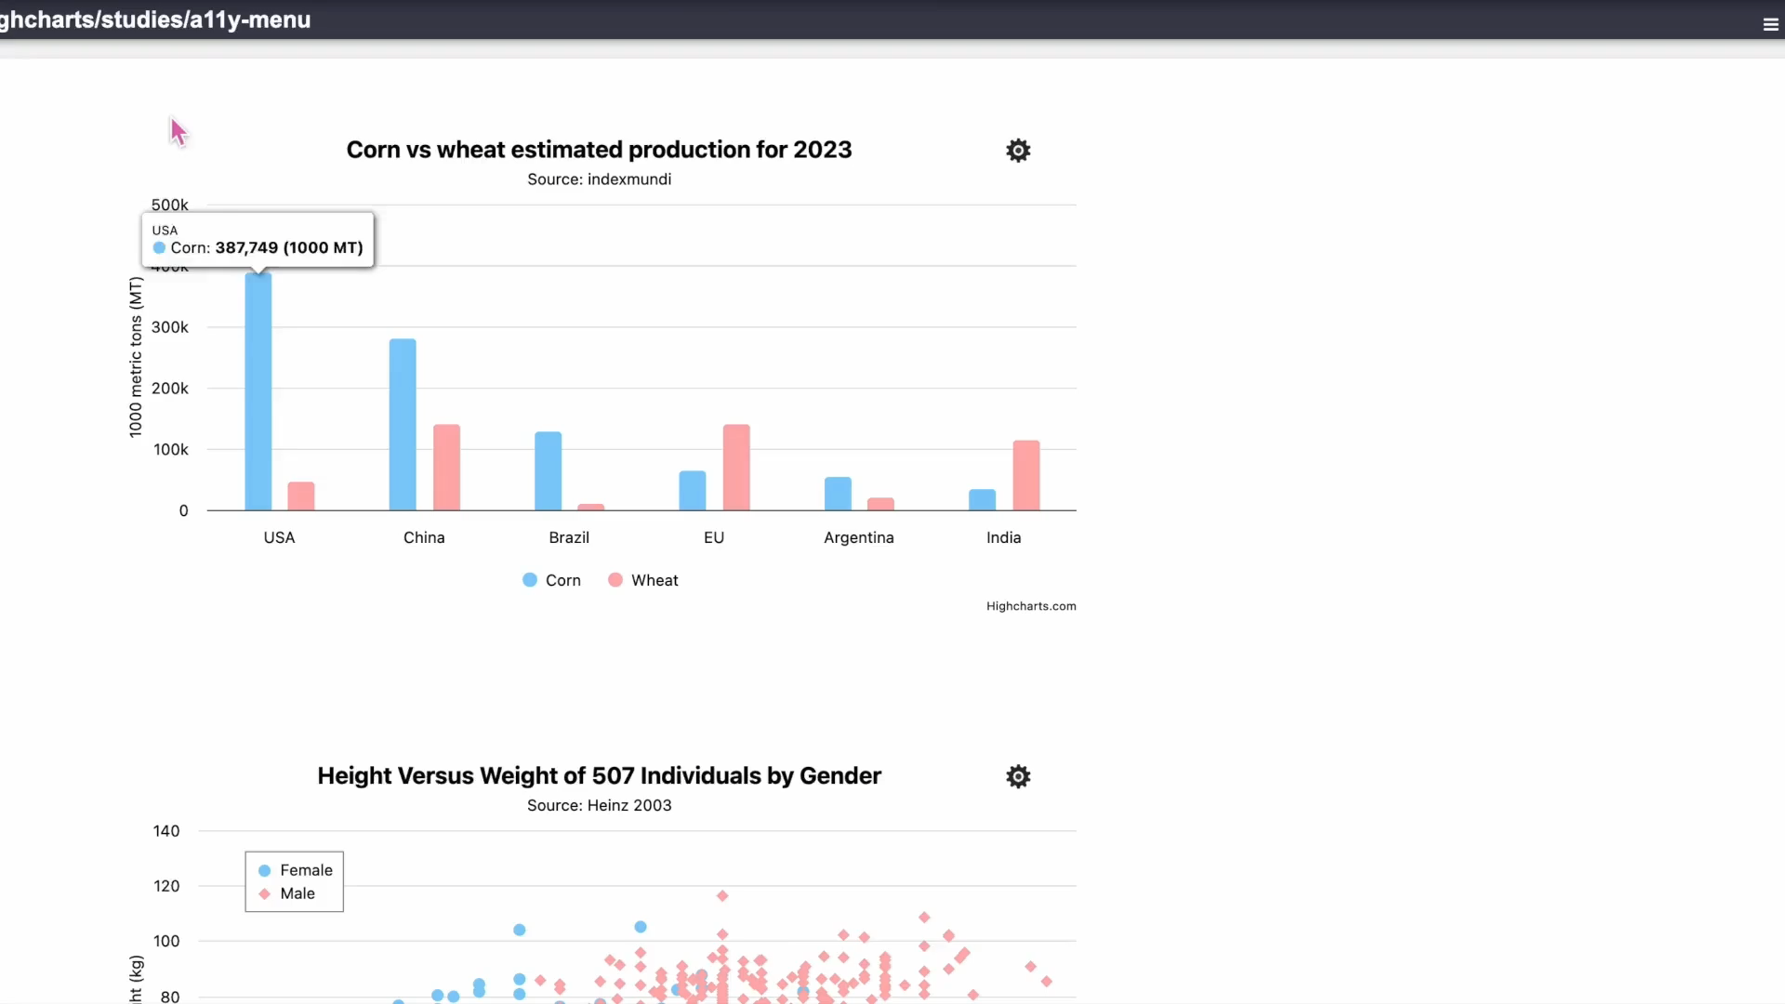
Current prototype
(Insert video of end result of PoC)
Notes:
Before video:
We'll be happy to demo this at our booth in the exhibit hall
After video:
This leads me into my next slide to talk about global vs local chart settings

Slide 58
Key learnings
Global vs local chart settings
Screen reader users are not clicking the button
Full/short chart summary
Low vision users appreciated visible descriptions
Perfect wording is hard to find
Structure of the menu
Low vision users takes the time to tweak
Notes:
Global vs local chart settings
Most users liked that it was local per chart
Gives flexibility
Default: dark/light, font size
Screen reader users are not clicking the button
They would expect that there is nothing for them in the settings.
Experimented with different accessible names
No one would click it until cued.
Full/short for chart summary
Some users did not seem to detect that there was a noticable change.
Some cued and liked it
Low vision users appreciated visible descriptions
No mouse/keyboard to explore
Making it less of a cognitive load viewing all at once
information overload for some, fine line
Perfect wording is hard to find
The concept of default text size
The concept of system default
Find the best way to create option names to engage users at the right times
Some screen reader users were excited by the “visible alt text”
One low vision user did not want to click “show point description” which was previously called “show point alt text” that because he instantly thought not relevant because he was not using a screen reader
The structure of the menu
Was a dialog that you could close
Labelled with headings for each interactive elements group
Easy to navigate both for sighted and screen reader users
Low vision users takes the time to tweak
They enjoyed setting it up.

Slide 59
"When you end up with something that is just right for me, you enjoy using it more. If it is just 5% better, and you are using it hours a day. That makes a difference."
User tester
Notes:
“When you end up with something that is just right for me, you enjoy using it more.”
“If It is 5% better, and you are using it hours a day, that makes a difference.”

Slide 60
Next steps?
accessibility@highsoft.com
accessibility@elsevier.com
fje@cmu.edu

Slide 61
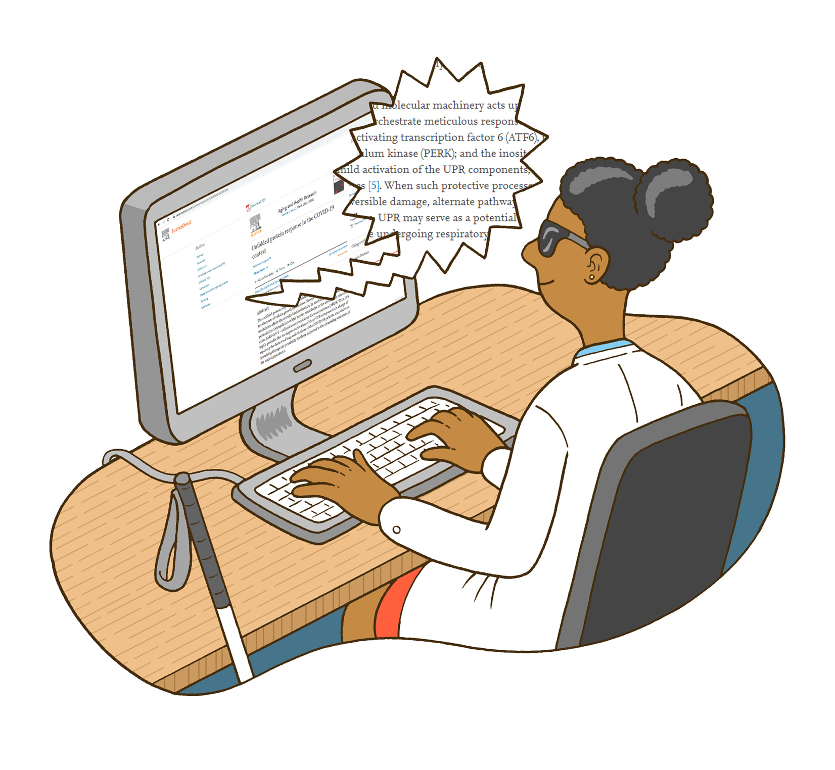
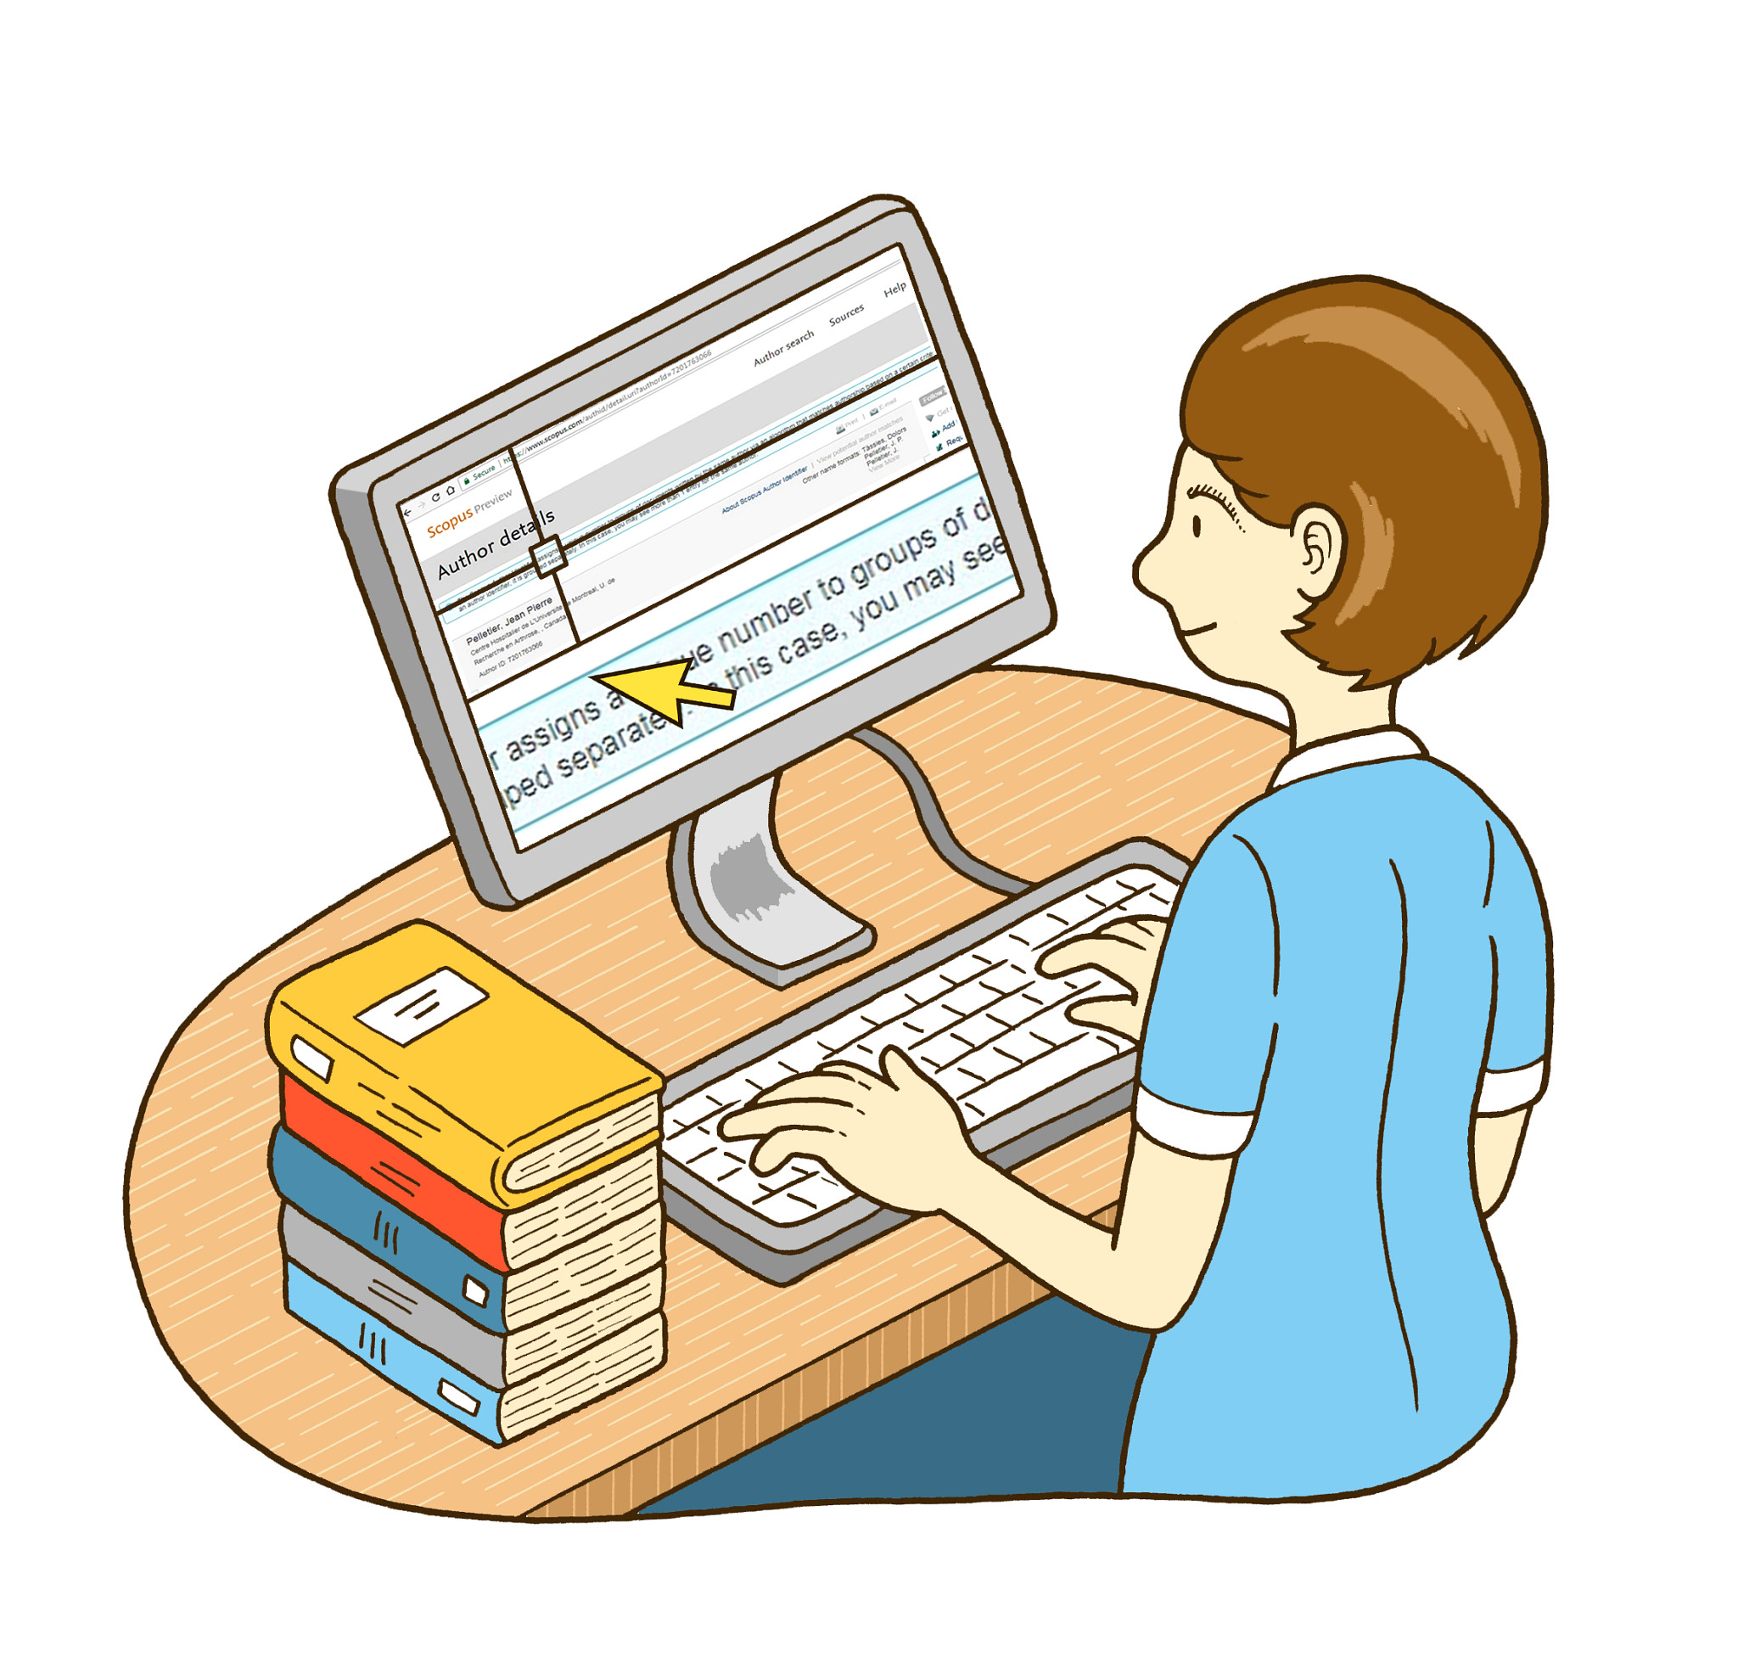
Today's Focus on Personalization of Accessible Data Vis and 2 Key Personas
Blind / Screen Reader User
Low Vision / Screen Magnification
Multi-modality (sonificaton, TTS)
Descriptions on Demand
Label Verbosity
Tooltip Behavior
Text Label Size
Color Themes
High Contrast
Border Adjustments

Slide 62
Prototype evolvement
Notes:
So in the end, we ended up splitting the preferences menu into two sections where one section was for preferences and the other were for accessibility tools.
For the preferences setting we did:

Slide 63
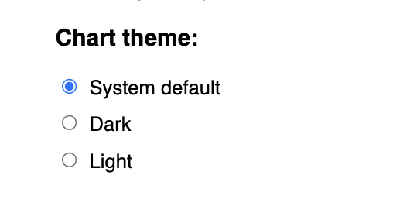
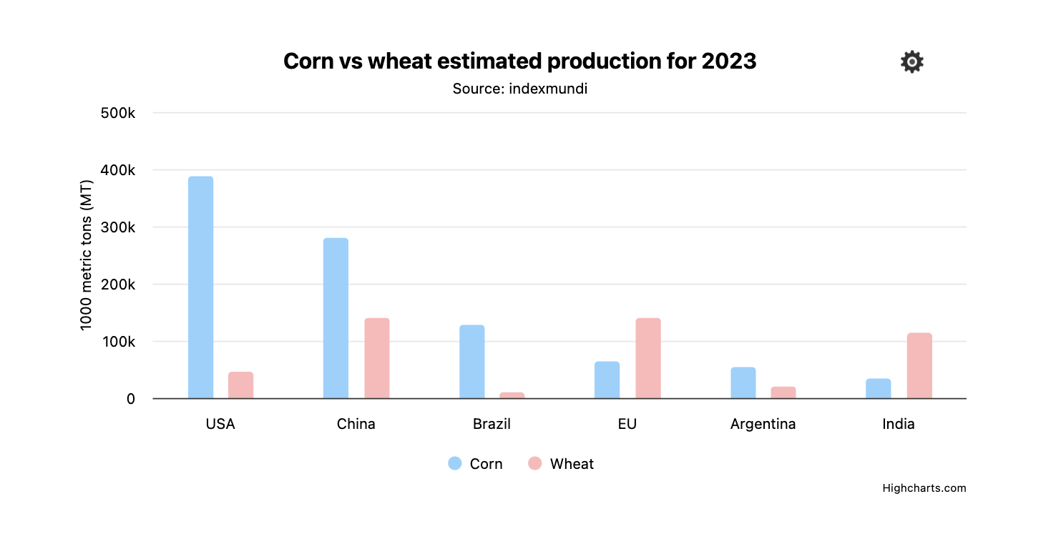
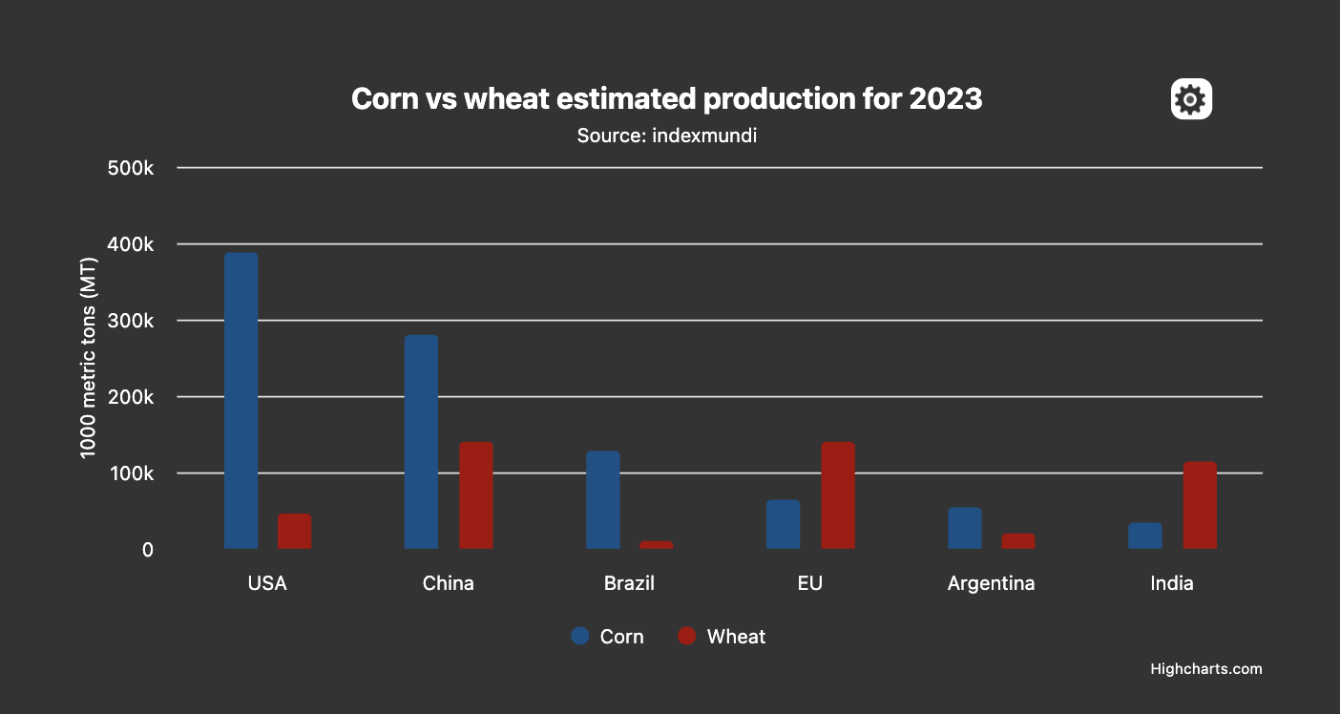
Preferences: Chart theme
Notes:
Offers light/dark and a system default which is what your OS is set to

Slide 64
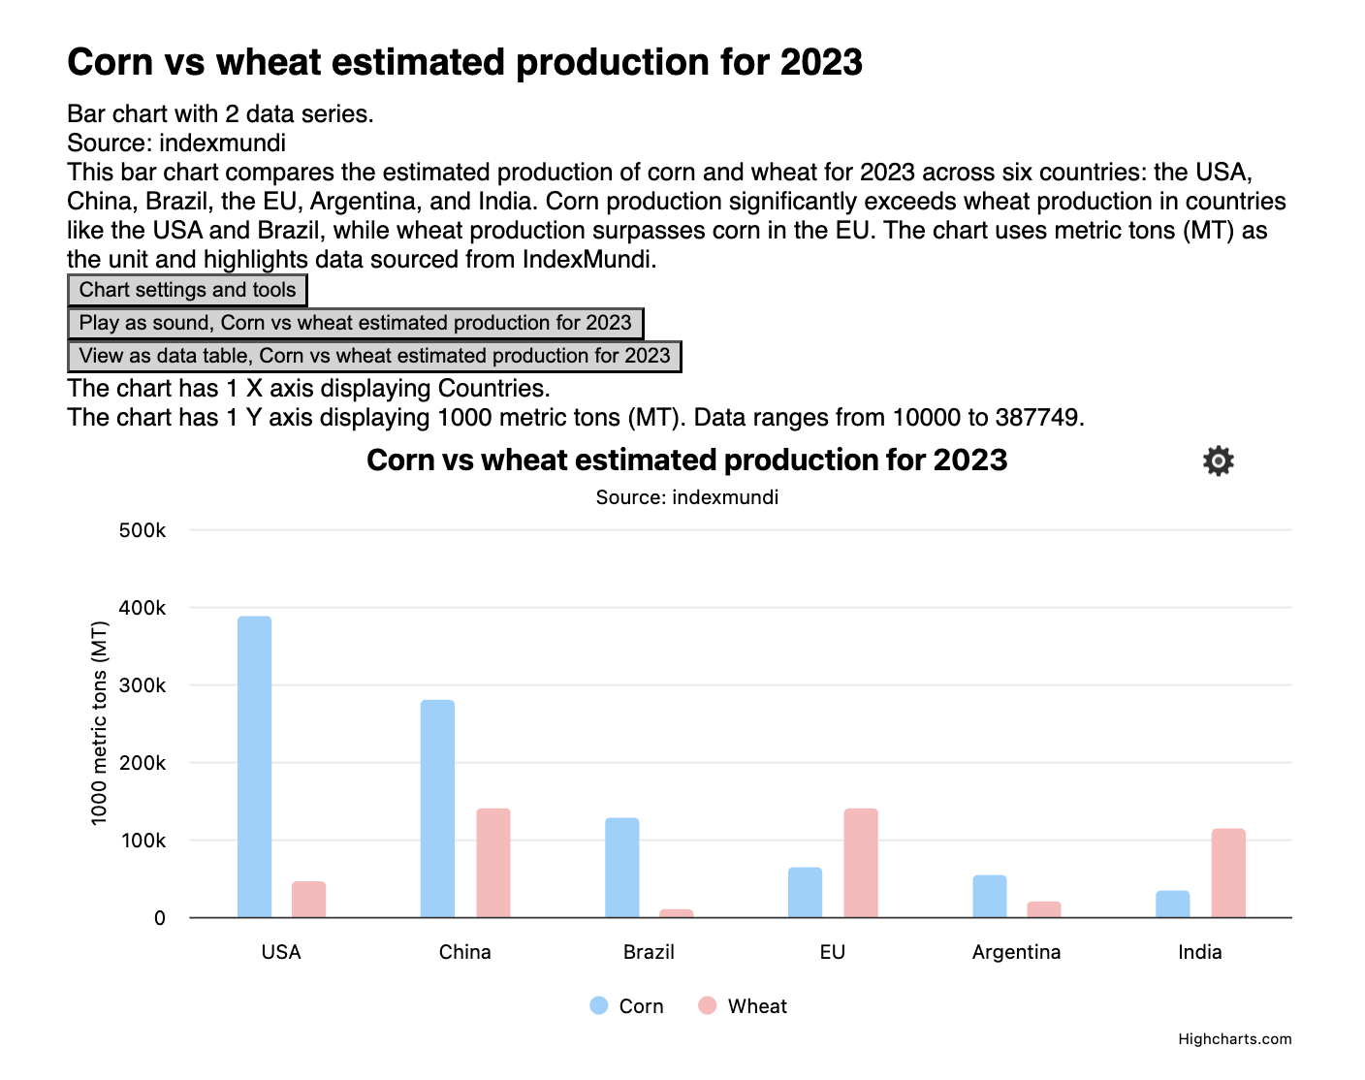
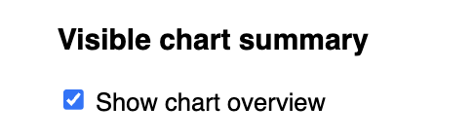
Preferences: Visible chart summary
Notes:
Visual setting
A checkbox for exposing screen reader information visually
To help with cognitively understanding the chart

Slide 65
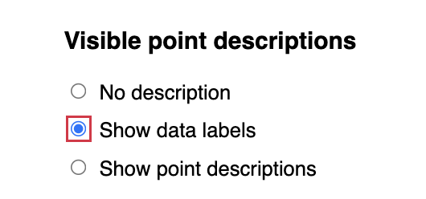
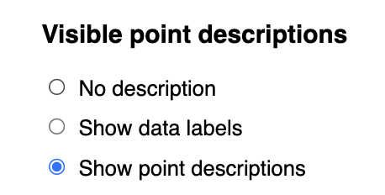
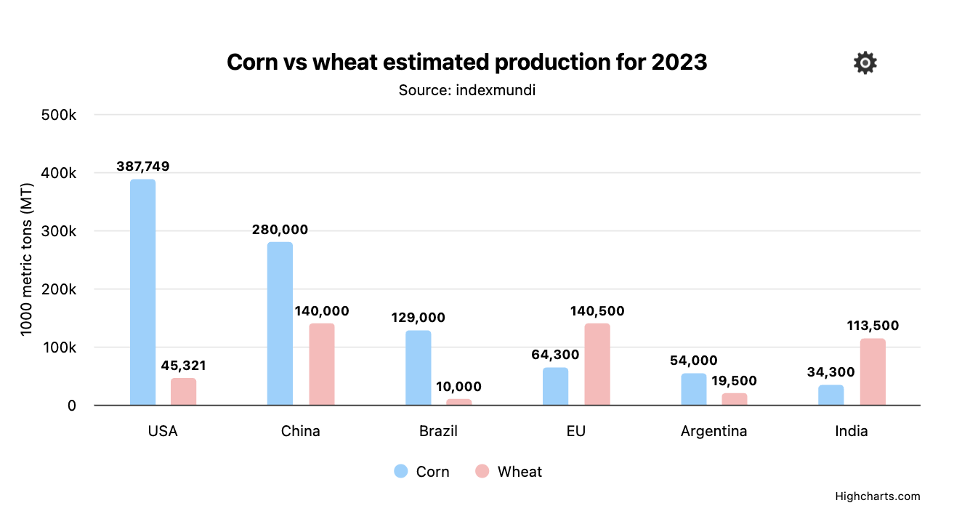
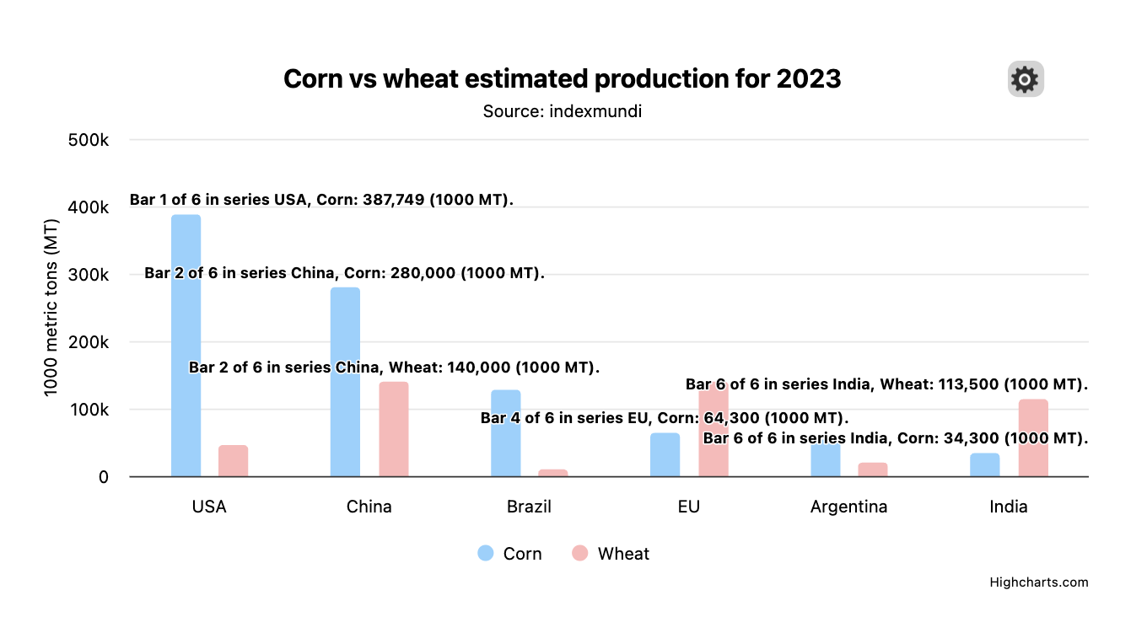
Preferences: Visible point description
Notes:
Visual setting
3 radio buttons to toggle between no point description, data labels and point description.
To be able to control how much text you are putting on the chart.

Slide 66
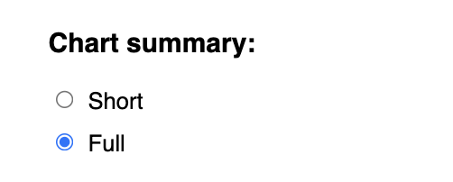
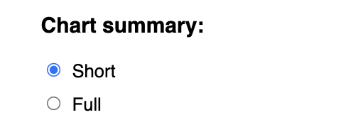
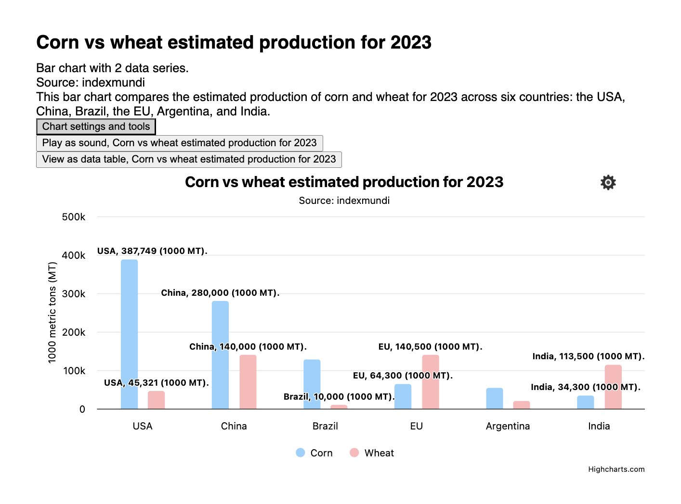
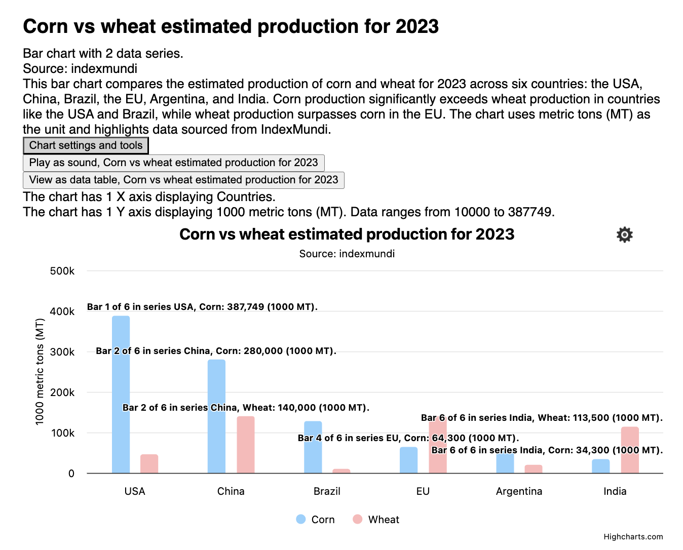
Preferences: Chart summary
Notes:
Visual and screen reader
Toggle between short and full with radio buttons
It will shorten or expose full information about a chart both visually (if you checked chart overview and visible point desc) and for a screen reader user.

Slide 67
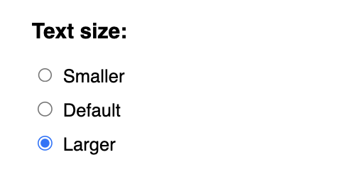
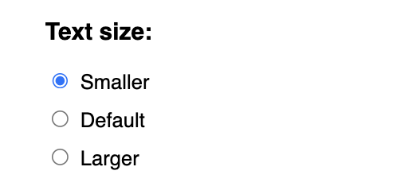
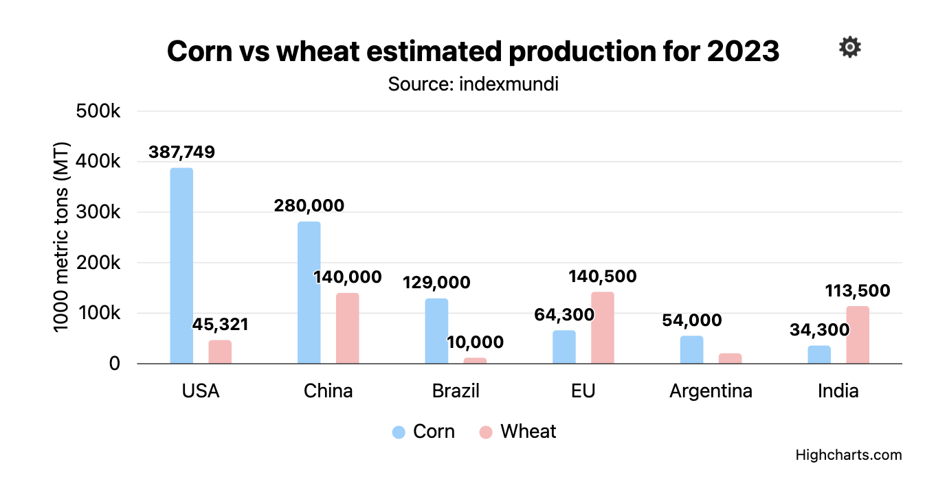
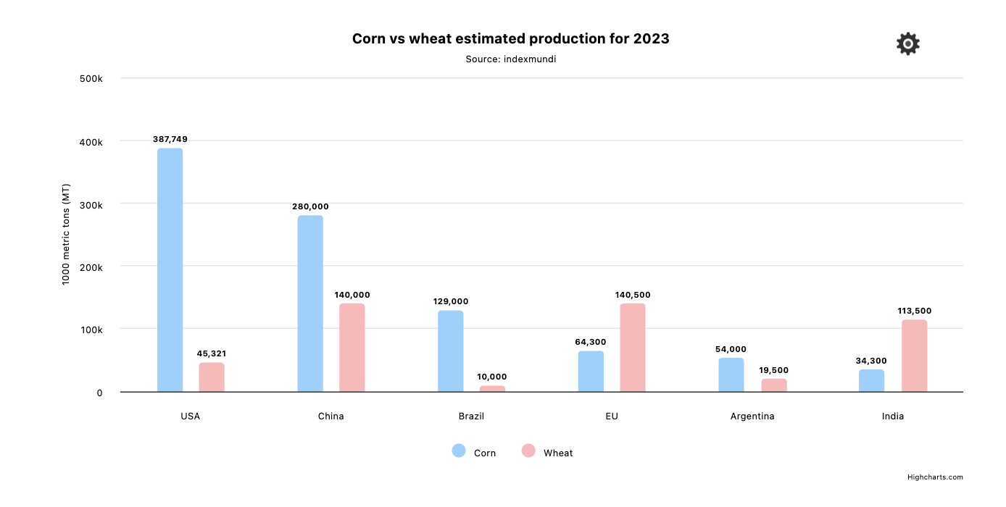
Preferences: Text size
Notes:
3 radio buttons to select text size
Three different text sizes, a default one and 4 px larger and 6 px smaller than that.
10, 16, 22 px

Slide 68
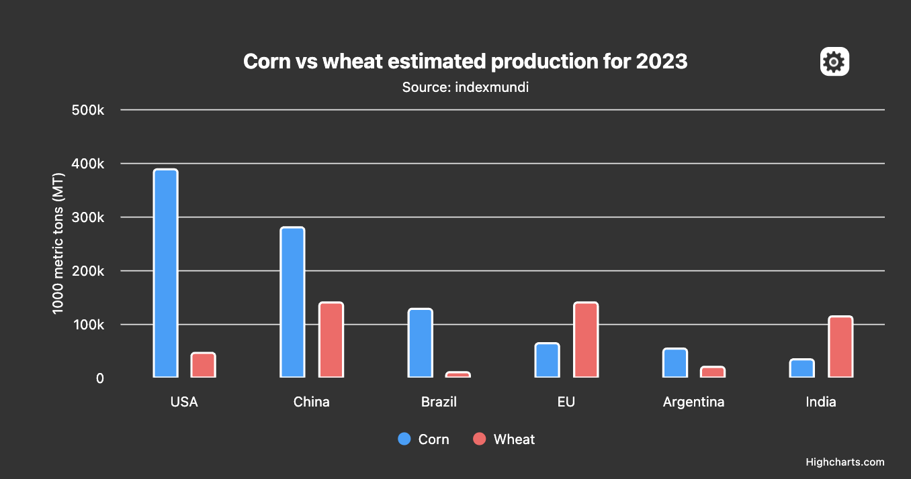
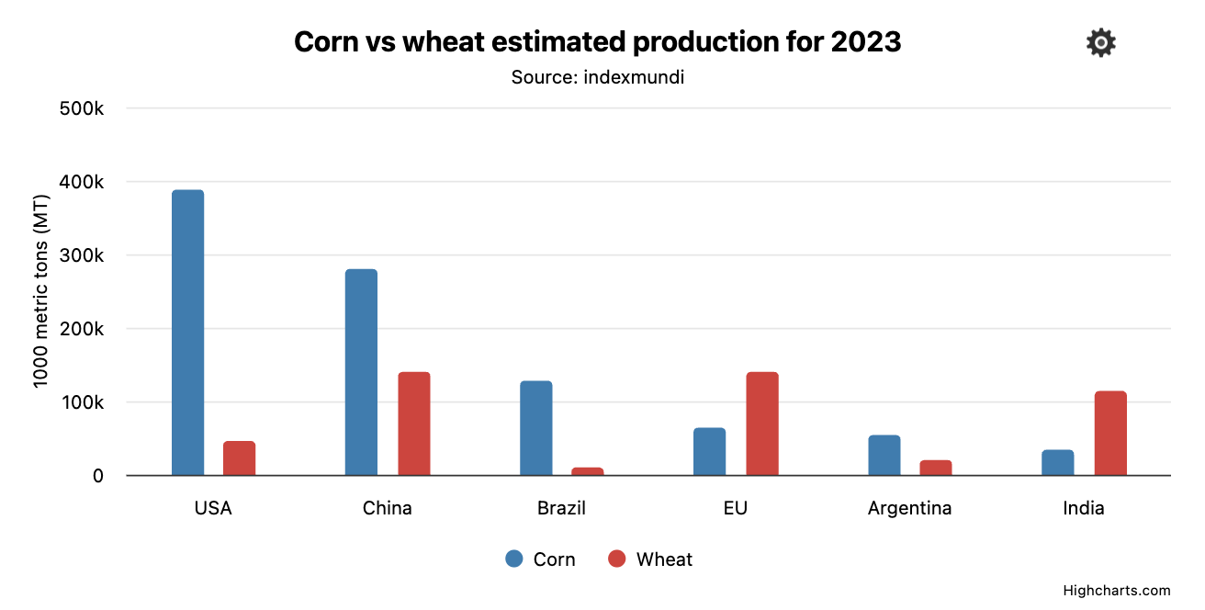



Preferences: Enhance contrast
Notes:
Three checkboxes
Increase contrast -> enhance the contrast already set
Add border → Add a border around the columns, will detect if enhance contrast is checked and create a darker border
Patterns instead of colors
Apply a pattern that also takes in if contrast is checked or not
Reset to default
We saved all of the settings by using local storage, so if you were to close the page

Slide 69

Accessibility tools
View as
Sonification
Chart description
Notes:
For the tools we did:
View as
Toggle the chart between a visiible chart, table and description.
Also what is exposed to a screen reader
Sonification
Play chart
Play chart with speech where each data series is announced
Chart description
A button to describe the chart.

Slide 70
What worked?
Showing point descriptions
Dark/light mode
Contrast enhancements
Sonification
The structure of the menu
Notes:
Global vs local chart settings saves
Most users liked that it was local per chart
Gives flexibility
Default: dark/light, font size
Showing point descriptions
Did not have to look with mouse/keyboard for values
All displayed at the same time, easier to compare
Dark/light mode
All low vision users appreciated this
Some screen reader users appreciated
Contrast enhancements
Able to both increase and add border is key
Pattern is still either you like it or you dont
Sonification
Most of our screen reader users appreciated being able to play the chart
The structure of the menu
Was a dialog that you could close
Labelled with headings for each interactive elements group
Easy to navigate both for sighted and screen reader users
Keeping navigation predictable

Slide 71
What did not work?
Overlapping data labels and point descriptions
Screen reader users checking “visible chart summary”
Screen reader users not clicking the menu
Full/low for chart summary
Notes:
Overlapping data labels and point descriptions
Highcharts data labels not overlapping
Took away some of the values to make space for others
Need to work on
Screen reader users checking “visible chart summary”
Screen reader users not clicking the menu
Preferences was offered twice, before the chart in the screen reader section and a visible button next to the chart menu.
When asked about it everyone had noticed the preferences button.
Full/low for chart summary
Some users did not seem to detect that there was a noticable change.
Some cued and liked it

